Slide 1

Neutron and X-ray Scattering
At small angles
Philipp Gutfreund
ILL, Grenoble, France
gutfreund@ill.eu
TU Berlin, July 26, 2017

Slide 2
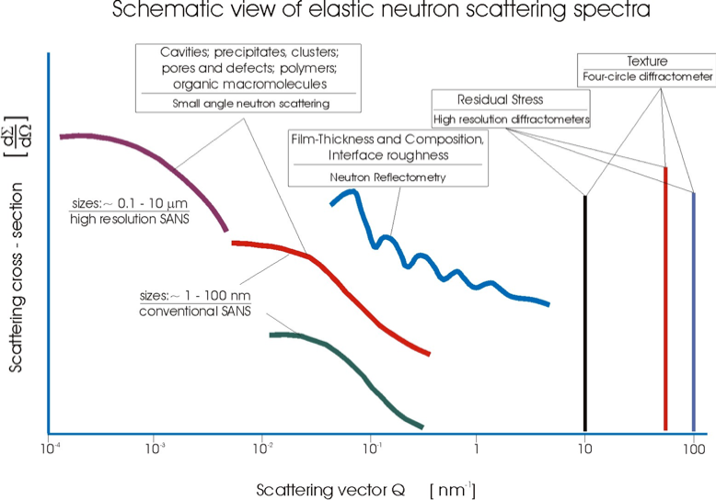
_________________________________
Giovanna Fragneto HERCULES 2012

Slide 3
Outline
  Fundamental Scattering Theory (Neutrons and X-rays)
  Small Angle Scattering Regime
  References
  Instrumentation

Slide 4
1. Fundamental Scattering Theory
(Neutrons and X-rays)

Slide 5
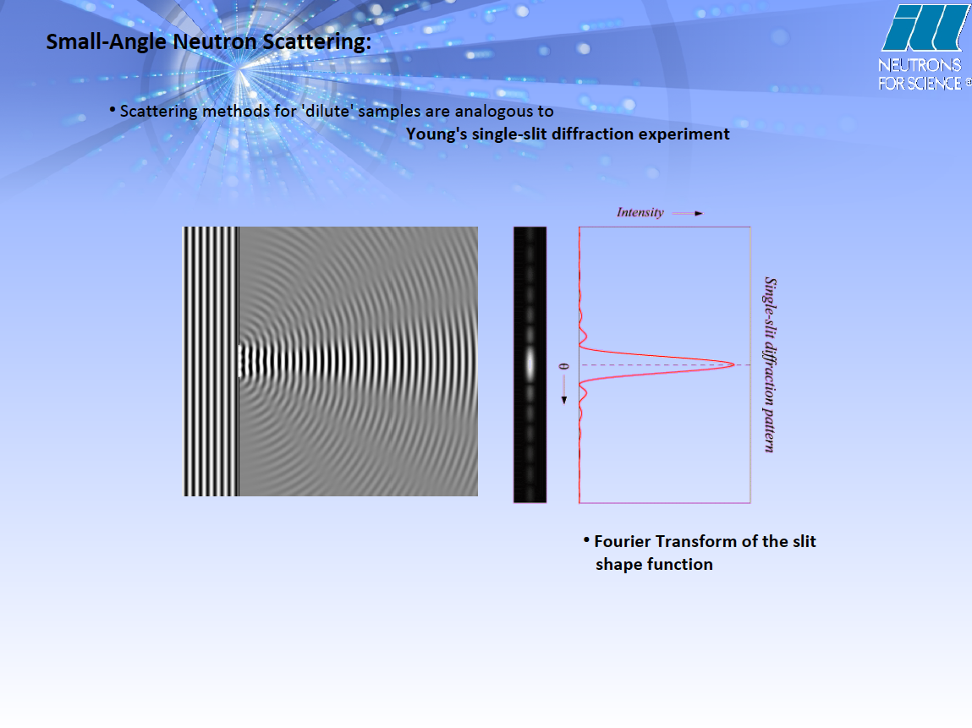
Fraunhofer Approximation
Momentum transfer:

Slide 6

Particle-wave duality
Schrödinger equation in vacuum (particle wave function ѱ):
For stationary case with:
Helmholtz equation
Lorentz gauge from Maxwell equations w/o charge
(electromagnetic radiation: four-potential A):
For stationary case with:
Helmholtz equation
Neutrons and X-rays in vacuum can be described
by the same mathematical equation!

Slide 7
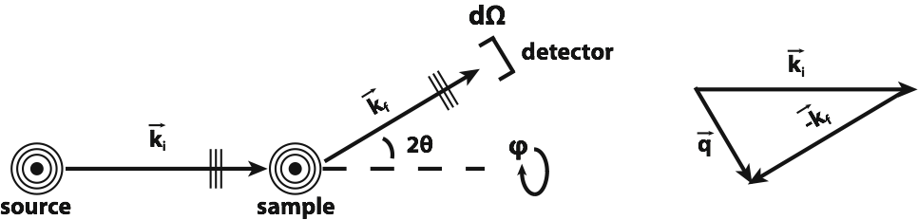

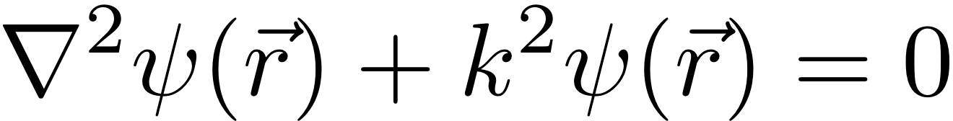
Fraunhofer Approximation
For stationary systems,
Helmholtz equation:
Plane waves:
Momentum transfer:
Wavelength

Slide 8
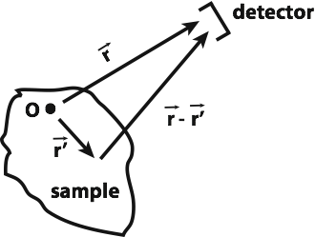
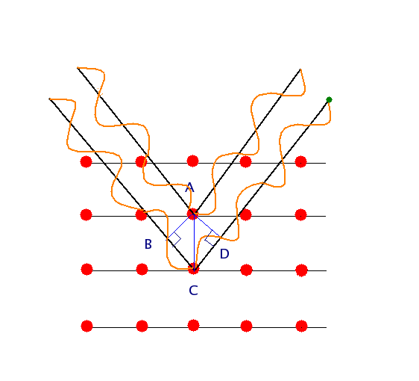


1st order Born Approximation
Inhomogeneous Helmholtz equation:
Ansatz:
Scattering function:
Assumptions:
Wave is the same inside and outside of the sample (kinematic approximation)
Interaction potential is small (perturbation theory)
Single scattering event (1st order)
Neutron and X-ray scattering on a potential much smaller than the wavelength results in radial waves!
Notes:
The wave vector in the Angstrom range, the interaction potential is in the fm range, thus small. Common between neutrons and X-rays is the wavelength. The scattering function is the Fourier transformation of the potential V.
Practical application: >90% transmission (single scattering)

Slide 9
2nd order Born Approximation?
Scattering function f⁽²⁾ (for particles):
Alternative: Model multiple scattering in data analysis (used in SANS).

Slide 10



Elastic differential cross section
No inelastic scattering considered:
Out of the direct beam:
Alternative:
Fermi’s golden rule:
Notes:
The quantity measured in a scattering experiment is the differential cross section.
If we build the absolute square of the probability function and ignore cross terms of the direct and scattered beams (no multiple scattering) we end up with the absolute square of the scattering function as the resulting cross section out of the direct beam.

Slide 11
Potential V(r) for neutrons?
Cold neutron wavelengths on Å length scale
Scattering on nuclei (strong interaction) of fm size
Point scattering
Scattering function:
Scattering Function of a single nucleus is described by a single number!
Definition of scattering length b:
For X-rays: r₀²P
Fermi pseudo potential:
Notes:
Scattering on a single point.

Slide 12
Scattering Function for Crystals
Crystal lattice with basis vectors a,b and c:
Scattered intensity from a crystal peaks on other lattice points in reciprocal space!
Diffracted Intensity from N atoms with scattering length b:
Product of three geometrical progressions, can be simplified for N > 1:
Far large N this function peaks at q vectors obeying the Bragg condition:
Notes:
Scattering on an assembly of points. I show a structure factor of a liquid here, as an example.

Slide 13
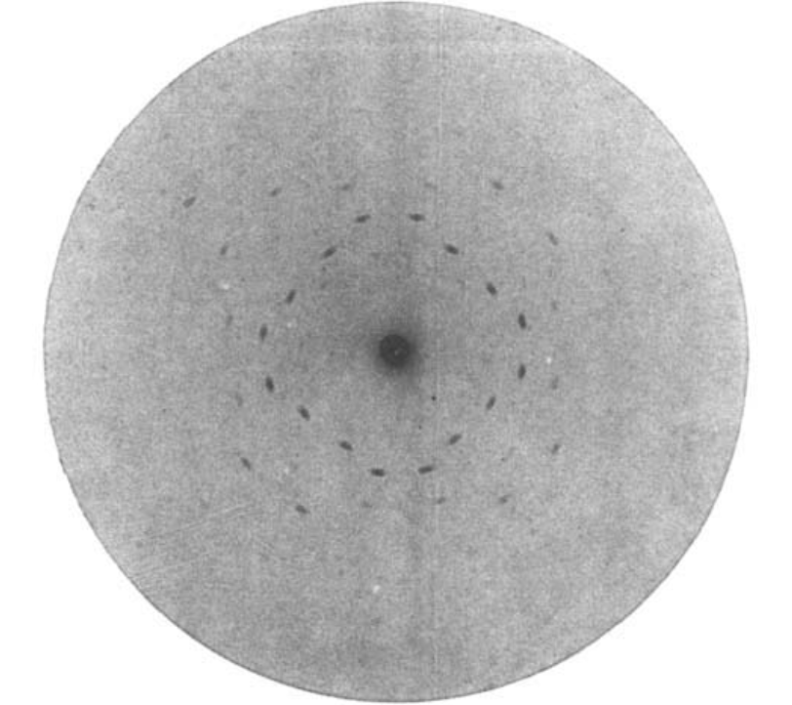
Scattering Function for Crystals
X-ray diffraction image from a ZnS crystal:
Proof that X-rays are composed of transversal waves in the Ångström range and crystals have ordered lattice spacing on the same length scale!
Nobel prize in Physics in 1913
W. Friedrich, P. Knipping, M. von Laue., Annalen der Physik 346, 971-988 (1913)

Slide 14

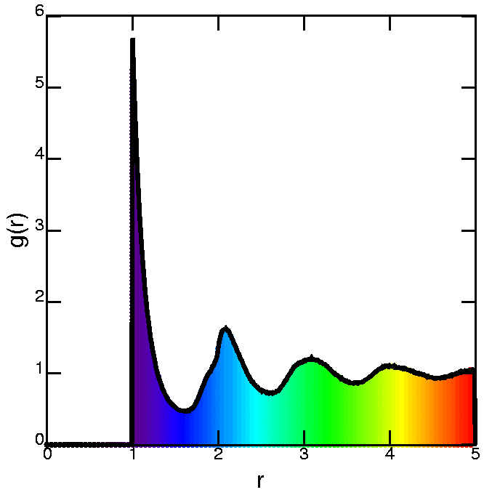
Scattering Function for Liquids
Diffracted Intensity for isotropic liquids (point scatterers of strength b):
Pair correlation function g(r):
figures from physics.emory.gov
Scattered intensity proportional to FT of the density pair correlation!
Notes:
Scattering on an assembly of points. I show a structure factor of a liquid here, as an example.

Slide 15
Scattering Function for Polymers
Diffracted Intensity from N particles:
Scattered intensity proportional to Debye function for Gaussian chains .
D.G.H. Ballard et al., Eur. Polymer J. 9, 965 (1973)
R.G. Kirste & W.A. Kruse, Polymer 16, 120 (1975)
For a single Gaussian polymer chain with N (pointlike) monomers of length a and scattering length b:
Debye function:
Radius of gyration:
Notes:
Scattering on an assembly of points. I show a structure factor of a liquid here, as an example.

Slide 16
Neutron-matter interaction
Neutrons only see the magnetization perpendicular to the scattering vector!
Interaction neutron-nucleus
  Isotropic and ponctual
Zeeman interaction
  Neutron spin – magnetic field
Neutron-nucleus
Neutron-magnetic field
Neutron-magnetisation
permeability
g-factor
nuclear magneton
Pauli spin matrix
Notes:
The Fourier-transformed magnetization of the sample M|| is the component in-plane of the surface (for NR) (but perpendicular to q)!

Slide 17
Comparison nuclear and magnetic neutron scattering lengths.

Slide 18
Spin scattering
Fermi Golden rule:
Pure nuclear scattering:
Nuclear scattering is entirely non-spin-flip.
Non-spin-flip scattering is sensitive to magnetization parallel to neutron spin.
Spin-flip scattering is sensitive to magnetization perpendicular to neutron spin.
Notes:
If we do the calculations we see that the spin incoherent scattering adds with a factor of 1/3 to the total incoherent scattering. (R. Stuart script)

Slide 19
Coherent/Incoherent Scattering
Spin-incoherence:
Probability
Neutron Spin:
Neutron+
(random) nucleus spin:
Average (coherent) scattering length:
Strandard variation (incoherent) scattering length:
Same for natural distribution of isotopes (isotope incoherence)
Total cross section:

Slide 20
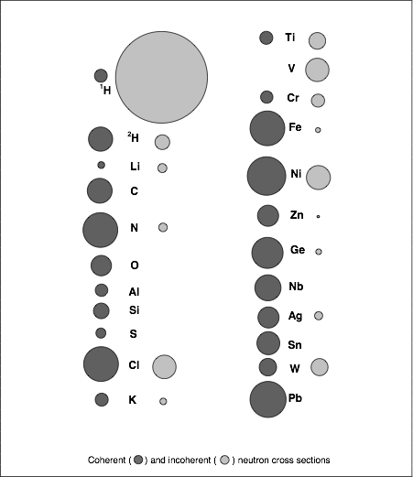
Neutron Scattering Cross Sections
Scattering at nuclei
Typical Wavelengths (cold neutrons) 2 Å - 30 Å
No charge, thus deeply penetrating matter
Possible contrast tuning by exchanging isotopes, especially Protons with Deuterons
Notes:
Some elements like oxygen have no incoherent scattering due to the absence of a nuclear spin and isotopes.

Slide 21
X-ray (Thomson) Scattering
X-ray scattering on one free electron
with classical radius r₀:
Polarization:

Slide 22
X-ray Atomic Form Factor
X-ray scattering on a cloud of free electrons (classical atom shell):
In reality electrons are bound in orbits, thus energy dependent correction f’(E) + absorption/inelastic scattering correction if’’(E).
Atomic form factor:

Slide 23
X-ray Atomic Form Factor
f⁰(q):
Atomic form factor:

Slide 24
X-ray Atomic Form Factor
Atomic form factor:

Slide 25
X-ray Atomic Form Factor
Atomic scattering functions:
Rayleigh
Thomson
f’(E)
inelastic scattering
f’’(E)
Photoeffect

Slide 26
Elastic Magnetic X-ray Scattering
Only unbound electrons
contribute and relativistic
correction:
Very weak (10⁻⁴ of Thomson)
Other possibilities:
magnetic circular dichroism
resonant magnetic scattering
Notes:
Check Daillant for details. For X-rays the spin-scattering is on the order of 10^-5 because only unpaired electrons contribute (Daillant Book)

Slide 27
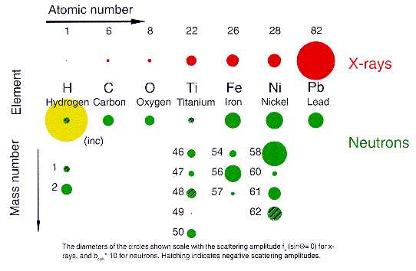
Scattering cross sections for neutrons and X-rays
Origins of scattering differ for the different methods.
X-rays dominated by number of electrons:
Neutrons rely on contrast of nucleus: similar for many different elements, but show strong variations from different isotopes of same element, especially hydrogen.

Slide 28
Difference of neutrons and X-rays
X-rays
High energy (keV)
High flux (synchrotron) or lab
0.5Å > λ >15Å
energy radiation damage
Small samples
Measure electron density and X-ray polarization
Can’t see hydrogen
surface specific (soft X)
wide q-range = good resolution
Neutrons
Low energy (meV)
Low flux (reactor, spallation)
1Å > λ > 30Å
energy Non-damaging
Large samples
Nuclear isotope and magnetic moment sensitivity
Can see hydrogen
Penetrating (buried interfaces)
small q-range = lower resolution

Slide 29
2. Small Angle Scattering
Regime

Slide 30
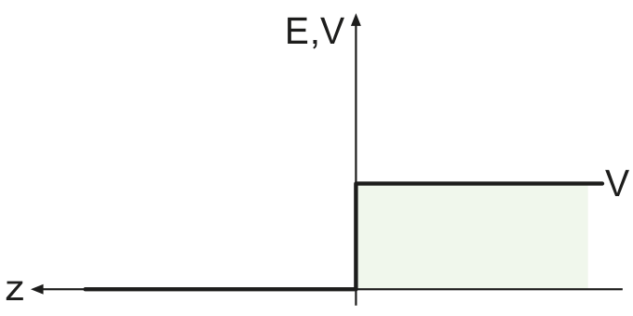
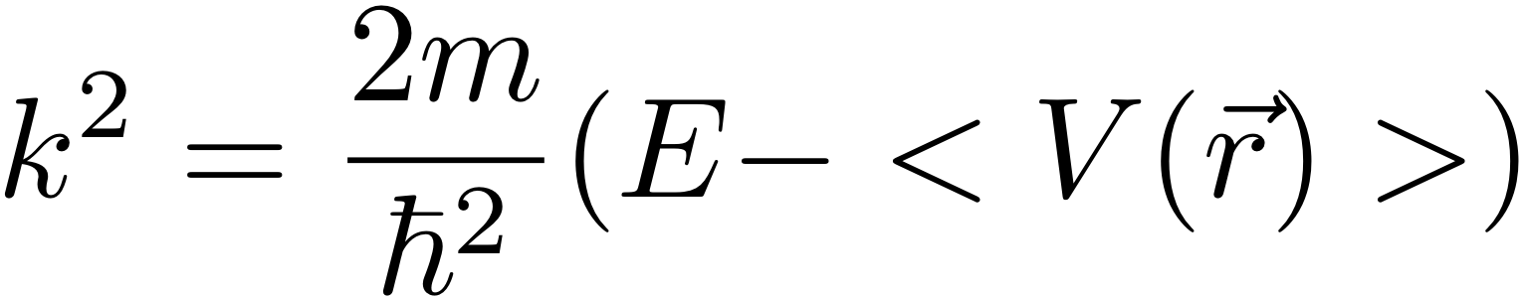
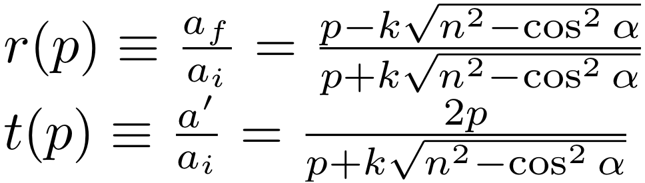
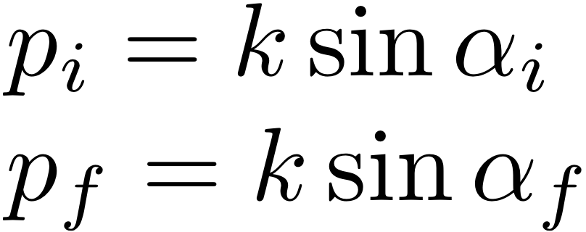
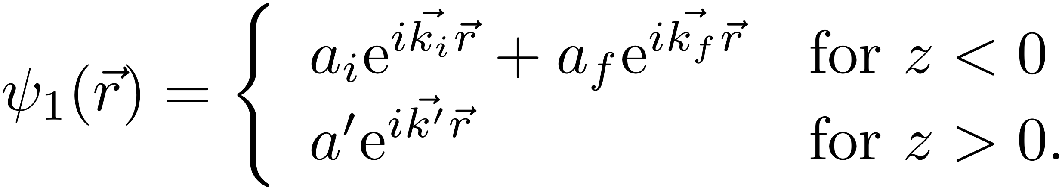
Exact solution of step potential (QM)
Helmholtz equation:
Fresnel functions:
Complete Solution:
Notes:
We can completely solve this problem and calculate the transmission functions of the incoming and reflected waves.
Here I used the z-axis projection.

Slide 31
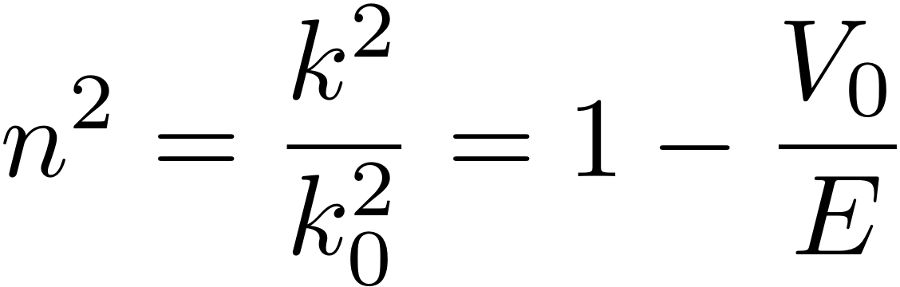
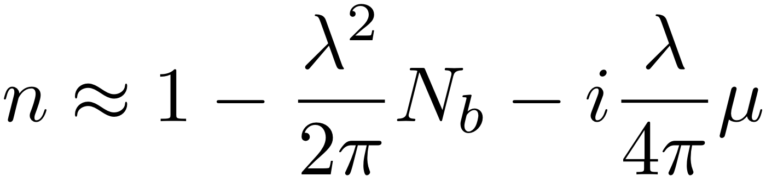
Scattering length density
Neutron, X-rays and light scattering at small angles
can be described by the same mathematical equation!
For small angle scattering the positions of individual atoms are not resolved,
Therefore the mean scattering length density (SLD) N_{b} is seen:
Optical refractive index:
SLD
Absorption coefficient
Classical electron radius
Atomic number
Neutrons:
X-rays:
Notes:
But, the refractive index is smaller than 1 in most cases: Total external reflection!
The SLD is wavelength independent. Show imaginary SLD. Uebung: n Selber ausrechen (Doktorarbeit S.28).

Slide 32
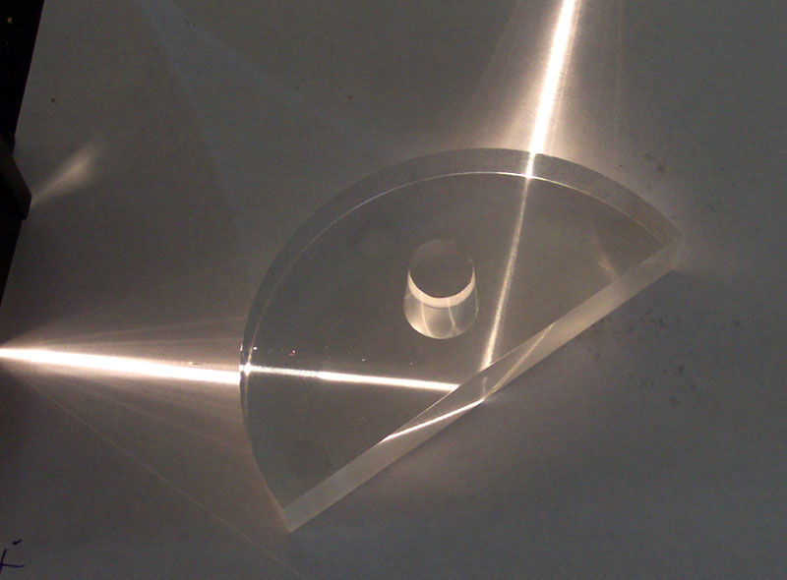
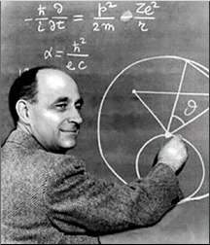
Total Reflection
For both kinds of radiation the refractive index is a function of the scattering length density and wavelength.
Total Reflection of neutrons was first observed in 1944 by Fermi and Zinn (Phys. Rev. 70, 103 (1946))
As with light, total reflection may occur when neutrons pass from a medium of higher refractive index to one of lower refractive index.

Slide 33
Scattering Function from an assembly of particles
The scattered intensity per unit volume V of an assembly of isotropic scatterers of individual volume Vp and volume fraction Φ is:
Volume fraction
of particles
Particle form factor
Volume of individual
particle
Particle structure factor
Difference of length scattering density
between particle and solvent
Notes:
The convolution theorem FT( int f(x)g(x-x1) dx)=FT(g(q))*FT(f(g)). Thus we can factorize the structure and form factors.

Slide 34
Scattering from Polymer melts
SANS from mixture of deuterated and protonated polymers:
Debye function
Fraction of deuterated molecules
Polymerization
Monomer volume
PDMS melt
SLD difference between deuterated and protonated monomers
With deuteration SANS can see individual polymer chains in an entangled melt!
Notes:
Scattering on an assembly of points. I show a structure factor of a liquid here, as an example.

Slide 35
Data Analysis
Routine analysis of reflectivity data would ideally be solved by direct inversion of experimental data into either scattering length density, Nb(z), or even volume fraction, f(z), profiles.
Generally, this cannot be achieved due to the loss of phase information.
Contrast Variation
More than one model of N_{b}(z) may give the same reflectivity profile – phase information is lost
Measurement with multiple ‘contrasts’ normally resolves ambiguity
Physical knowledge of system may define a unique model

Slide 36
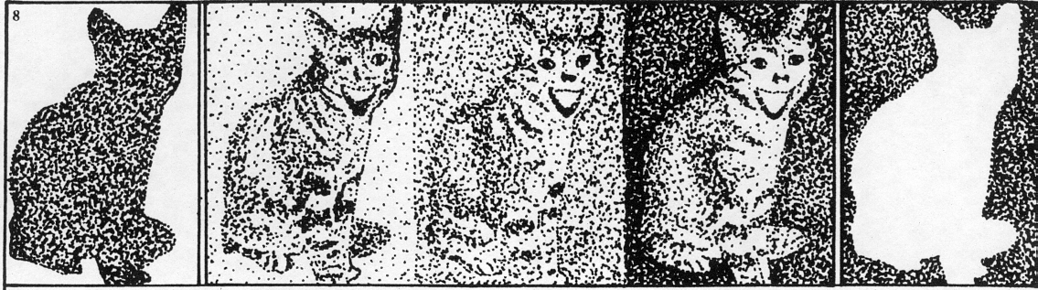
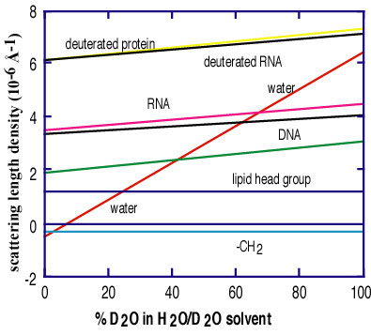

Slide 37
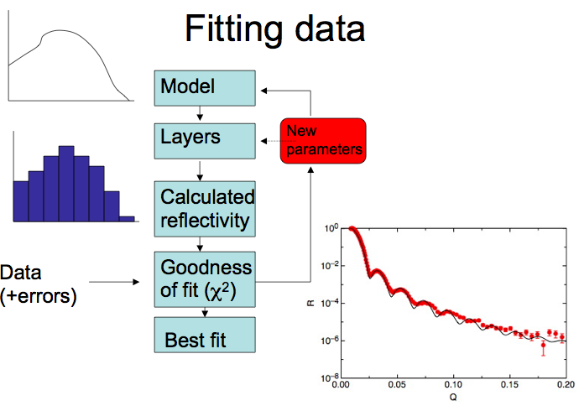
P = number of free parameters
N = number of data points

Slide 38
Some useful references:
  V. F. Sears 'Neutron Optics', Oxford Press, Oxford (1989)
  Lekner J 1987 in: “Theory of Reflection" Martinus Nijhoff Dordrecht
  Born M and Wolf E 1989 in: “Principles of Optics” Pergamon Press Eds. Oxford
  Penfold J and Thomas R K 1990 J. Phys. Condens. Matter 2 1369
  Russell T. P. 1990 Mat. Sci. Rep. 5 171
  Felcher G P 1981 Phys. Rev. B 24 1995
  Sinha S K, Sirota E B, Garoff S and Stanley H B 1998 Phys. Rev. B 38 2297
  Zhou X-L and Chen S-H 1995 Phys. Rep. 257 223
  W. Williams 'Polarized Neutrons' , Oxford Press, Oxford (1989)
  Névot L and Croce P 1990 Rev. de Phys. Appl. 15 761
  Daillant J and Gibaud A 1999 in:
  “X-ray and Neutron Reflectivity: Principles and Applications” Springer Eds.
  Heavens O S 1955 in: “Optical Properties of Thin Films”, Butterworths Eds. London
Web-sites:
http://www.mrl.ucsb.edu/~pynn/ (Roger Pynn)
http://www.pcl.ox.ac.uk/~rkt/ (Bob Thomas)
Cubitt R. and Fragneto G. 2002 “Neutron Reflection: Principles and Examples of Applications”, in Scattering, p. 1198-1208, Academic Press eds.

