Slide 1

Neutron and X-ray Small Angle Scattering and Diffraction under Grazing Incidence
Philipp Gutfreund
ILL, Grenoble, France
gutfreund@ill.eu
Uppsala University, April 8, 2014

Slide 2
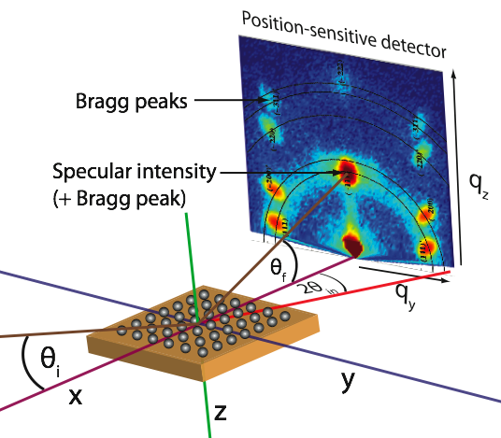
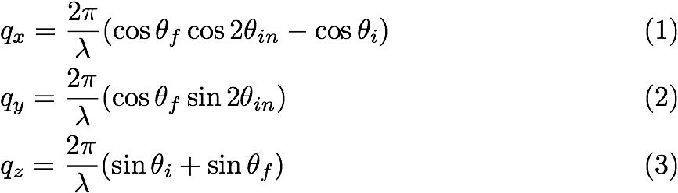
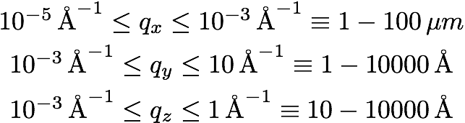
GISANS
Accessible q-range:

Slide 3
Outline
Diffuse Scattering from density inhomogeneities
Example I: In situ nano-island growth GISAXS
Grazing Incidence Scattering from density inhomogeneities near θ_{c}
Evanescent wave penetration depth
Example II: Depth resolving grazing incidence small angle neutron scattering (GISANS) on polymer micelles
Form factor, structure factor, polydispersity, instrumental resolution
Further scientific examples
References

Slide 4
1. Diffuse Scattering from
Density Inhomogeneities

Slide 5
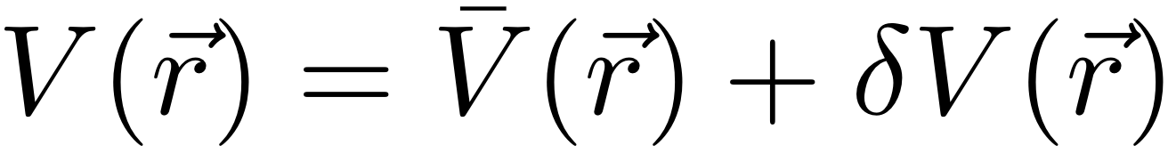
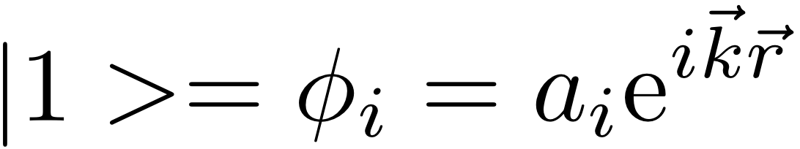

Perturbed step potential
Time reversed complete solution of step potential
(orthogonal complement to Ψ₁):
1st order perturbation theory (validity: |σq_{z}|<<1):
Notes:
The probability that an initial state 1 is transformed into the final state 2 by the potential V(r) can be approximated in the 1st order perturbation theory.

Slide 6
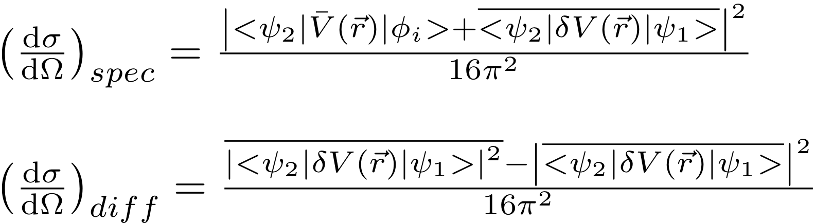

Perturbed step potential
With Fermi’s golden rule:
Specular part:
For qz > qc :
R_{F}: Fresnel reflectivity
Notes:
With the Fermi golden rule it can be shown that the absolute square of the probability is related to the cross section. The cross section can be divided into a coherent part (specular) and an incoherent part (diffuse) if we assume that deltaV is a fluctuating quantity and the result from statistical quantum mechanics: <|A+B|^2>=|A+<B>|^2+(<BB*>-|<B>|^2)

Slide 7
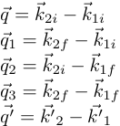



Perturbed step potential
Off-specular part:
Notes:
This complicated equation can be simplified for surface roughness scattering if we assume the wavefunction to be the same for all values of z>0, also in the shaded area. This is only valid for sigma*qz<<1, but not for large roughness (islands). This results in the surface approach (Sinha 1988 Eq.4.41)

Slide 8
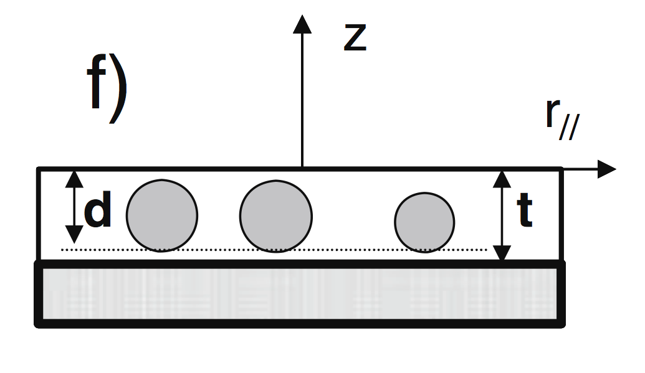

Density inhomogeneities
Off-specular part:
(Particle) Form factor:
Notes:
For density inhomogeneities we get a similar expression to roughness correlations.

Slide 9
Example I: In situ GIXD from metal nano-island growth

Slide 10
GISAXS from nano-islands

Slide 11
GISAXS on in situ nano-island growth
In situ GIXD at 650 °C:
Carbon replica TEM image of Pd islands on MgO substrate after vapor deposition:
Simulation using IsGISAXS
http://ln-www.insp.upmc.fr/axe4/Oxydes/IsGISAXS/isgisaxs.htm
by R. Lazzari.
from Renaud et al., Science 300 (1416) 2003.

Slide 12
3. Grazing Incidence Scattering from Density Inhomogeneities near θ_{C}

Slide 13
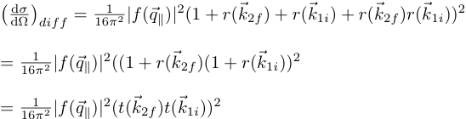

GISAS near θ_{c}
If θ_{i} and θ_{f} < θ_{c} one can simplify:
Fresnel:
In case of small incidence and exit angles the diffuse cross-section is just the absolute square of the in-plane form factor. Note: q_{z} is complex!
Notes:
For grazing incidence and exit angles smaller than the critical angle the perpendicular momentum transfer becomes purely imaginary.

Slide 14
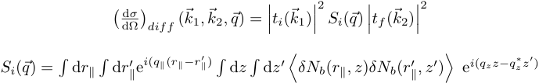
Density inhomogeneities
Diffuse Cross-section:
In case of symmetric in-plane disrtibution (z->z+z’):
With small absorption (neutrons) the cross-section scales with FT of the density inhomogeneities (SANS)
Notes:
Check Diploma thesis of O.Seeck for details. Bulk scattering does not decay as qz^-2 as surface scattering does -> Bulk scattering will dominate at large angles.
The integral over the imaginary part of qz means the evanescent wave penetration.

Slide 15
4. Evanescent wave penetration depth

Slide 16
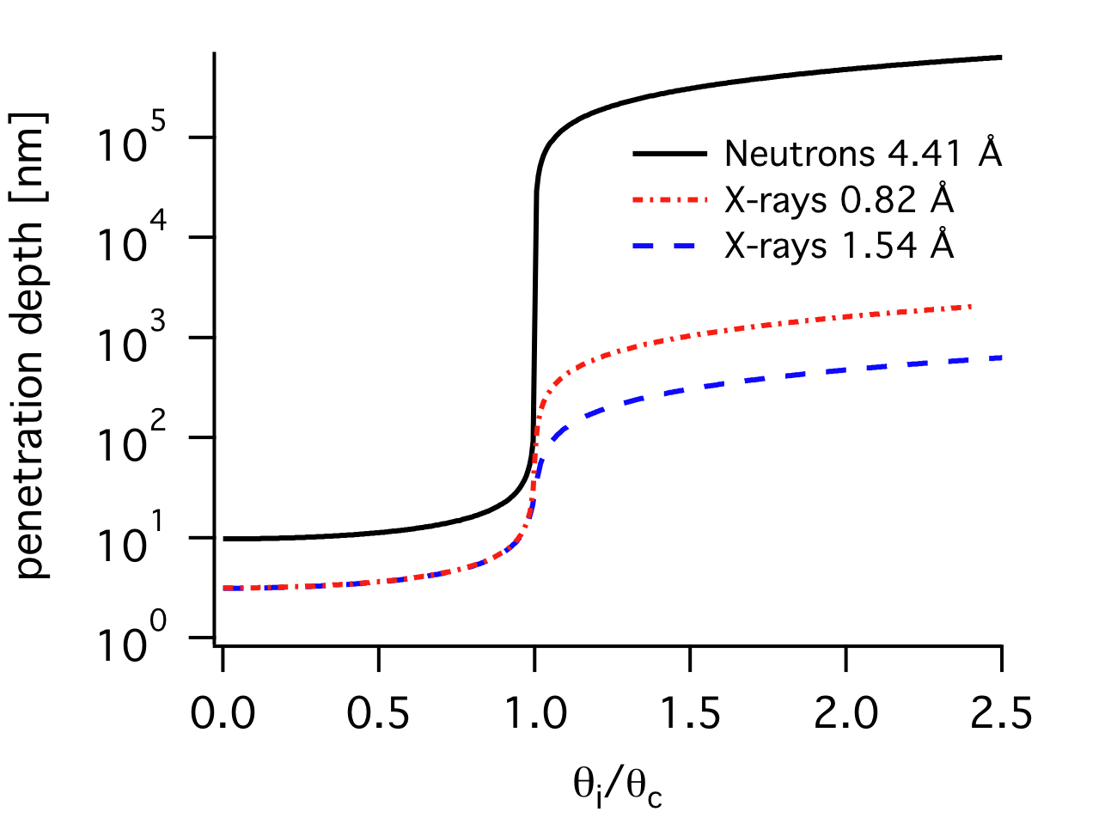
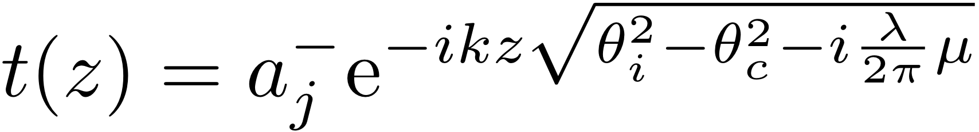
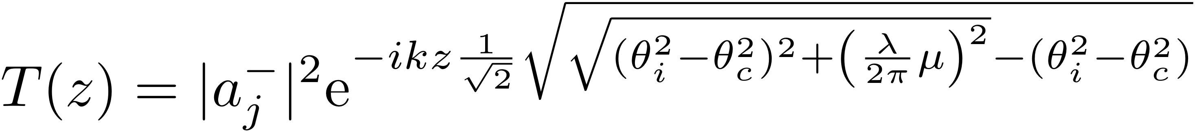
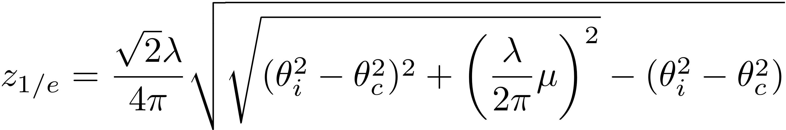
Penetration Depth
Transmitted amplitude:
and intensity:
Notes:
The z-projection of the transmitted wave of the general solution of the step potential can be compared to the absorption law.

Slide 17
Example II: Depth resolved Grazing Incidence Neutron Small Angle Scattering (GISANS) on polymer micelles

Slide 18
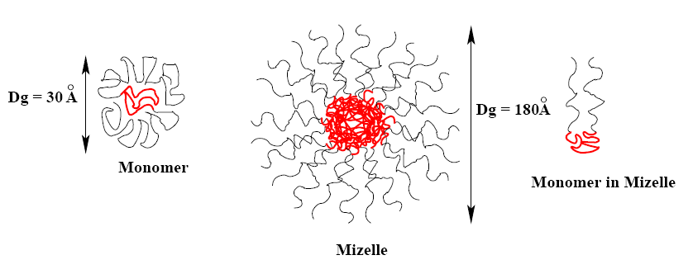
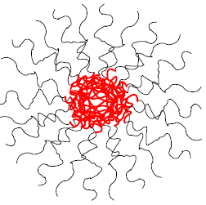
Pluronics
F127 (20 %): X=100, Y=65; (P123 (30 %): x=20, Y=70)
PEO hydrophilic
PPO hydrophobic
PEO hydrophilic
Solved in water (deuterated for the scattering experiments)
Unimer
Micelle
Crystall
Increasing concentration or temperature

Slide 19
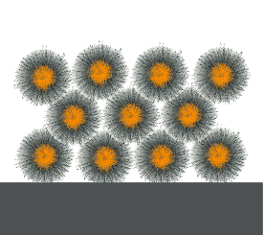
Depth resolved GISANS
GISANS patterns:
Wolff et al., J. Appl. Cryst. 47 (130) 2014.
FCC
neutrons
q_{z} correction:
Notes:
Due to the complex qz we need to correct to get the real part of qz.

Slide 20
6. Form factor, structure factor, polydispersity, resolution

Slide 21
Scattering Function from an assembly of particles
The scattered intensity per unit volume V of an assembly of isotropic scatterers of individual volume Vp and volume fraction Φ is:
Volume fraction
of particles
Particle form factor
Volume of individual
particle
Particle structure factor
Difference of length scattering density
between particle and solvent
Notes:
The convolution theorem FT( int f(x)g(x-x1) dx)=FT(g(q))*FT(f(g)). Thus we can factorize the structure and form factors.

Slide 22
Analytical expressions of form factors
Sphere
Multi-shell
Disk/cylinder
Ellipsoid

Slide 23
General behaviour of a scattering curve
Case of a dilute solution of uncorrelated particles
log(I)
q^{-n}
n=1: cylinder, 1D
n=2: disk, 2D
Molecular mass
Concentration
Δρ²
Guinier
range
(radius of gyration)
Local structure
Interface
(q⁻⁴)
log(q)
Analytical expressions for spheres, cylinders, ellipsoids, disks, muli-shell particles, Gaussian coils, …

Slide 24
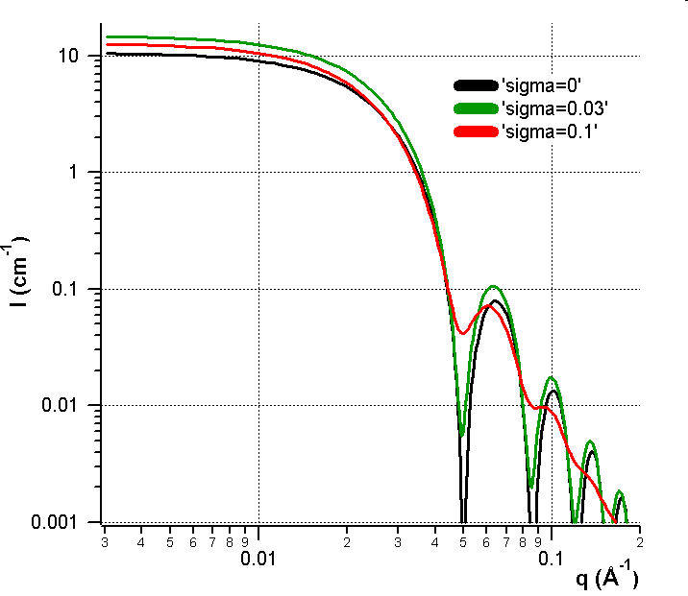
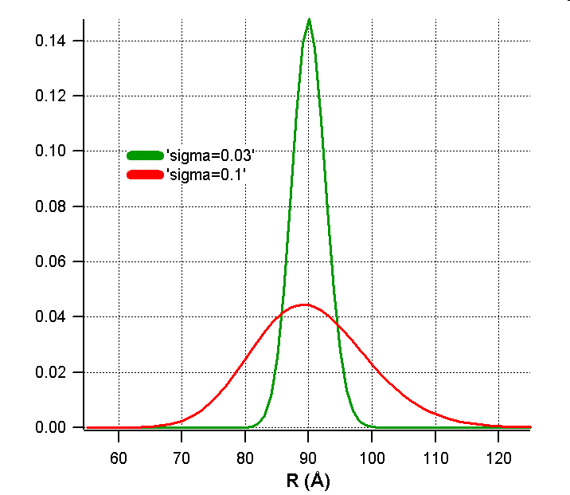
Polydispersity
Case of polydisperse spherical particles without interaction
Log-normal distribution
R = 90 Å

Slide 25
Summary
(
)
∫
∞
(
)
⎡
∫
∞
(
)
(
)
⎤
I
q
,
r
=
R
q
,
q
,
Δ
q
G
r
,
r
,
σ
S (q)
exp
o
o
o
o
⎢
o
P
r
,
q
dr
⎥
dq
0
⎣
0
⎦
Instrument resolution
Form Factor
Pedersen (Adv. Colloid Interface Sci. 1997, 70, 171)
Nallet et al.( J. Phys. II France, 1993, 3, 487)
Structure Factor
Percus-Yevick (Phys. Rev. 1958, 110, 1 )
Hayter-Penfold (Mol. Phys. 1981 42,109)
Polydispersity in size
(log-normal distribution)

Slide 26
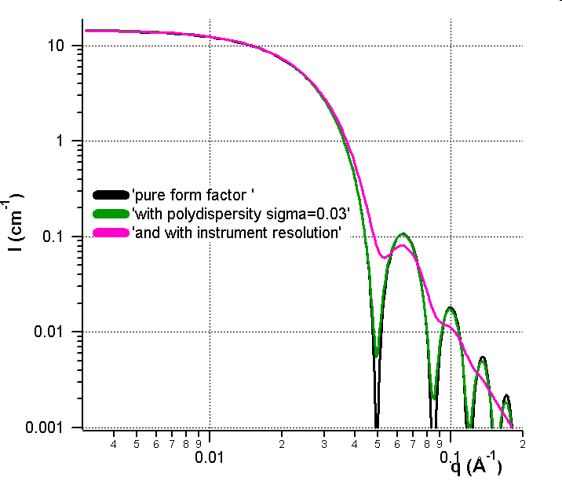
Combined effect of polydispersity and resolution
Favor the resolution rather than the flux
Importance of the instrumental resolution in the data treatment
More details… Effect of instrumental resolution and polydispersity on ideal form factor in SANS, I. Grillo, ILL Technical Report, 2001, ILL01GR08T

Slide 27
GISANS signal in Reflectometry
Divergent Ewald spheres:

Slide 28
Example III: Grazing Incidence X-ray Diffraction (GIXD) on Self-Assembled Monolayers

Slide 29
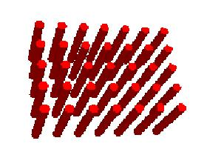
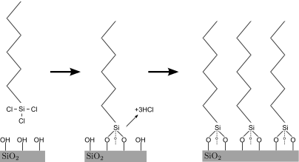
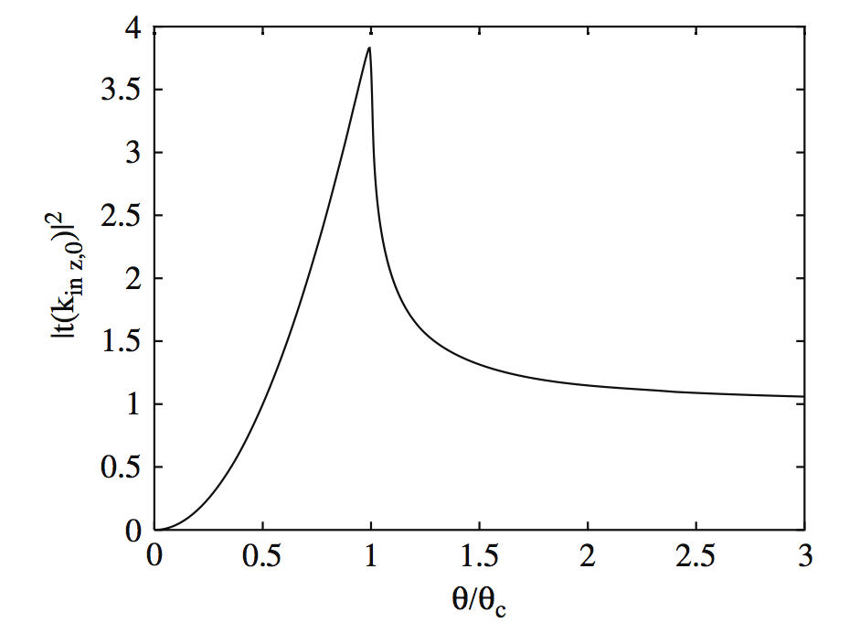
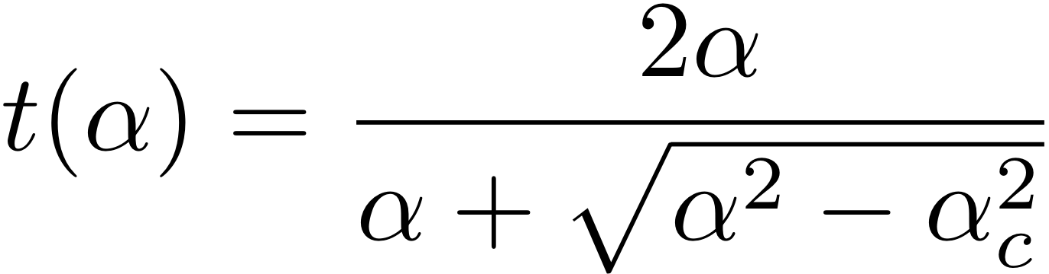
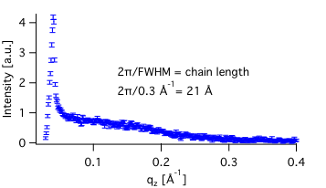
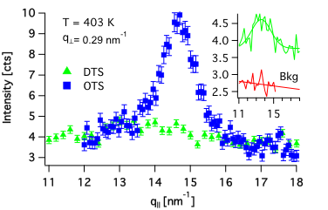
GIXD on SAMs
{1,0}
Hydrocarbon chains self-assemble into hexagonal packing:
Transmission function:

Slide 30
Example IV: Grazing Incidence X-ray Diffraction (GIXD) on Lipid Membranes

Slide 31
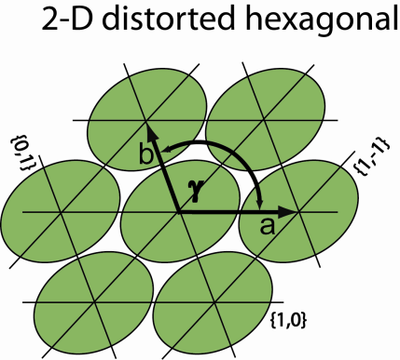
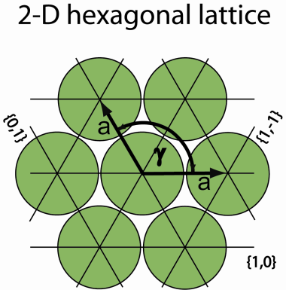
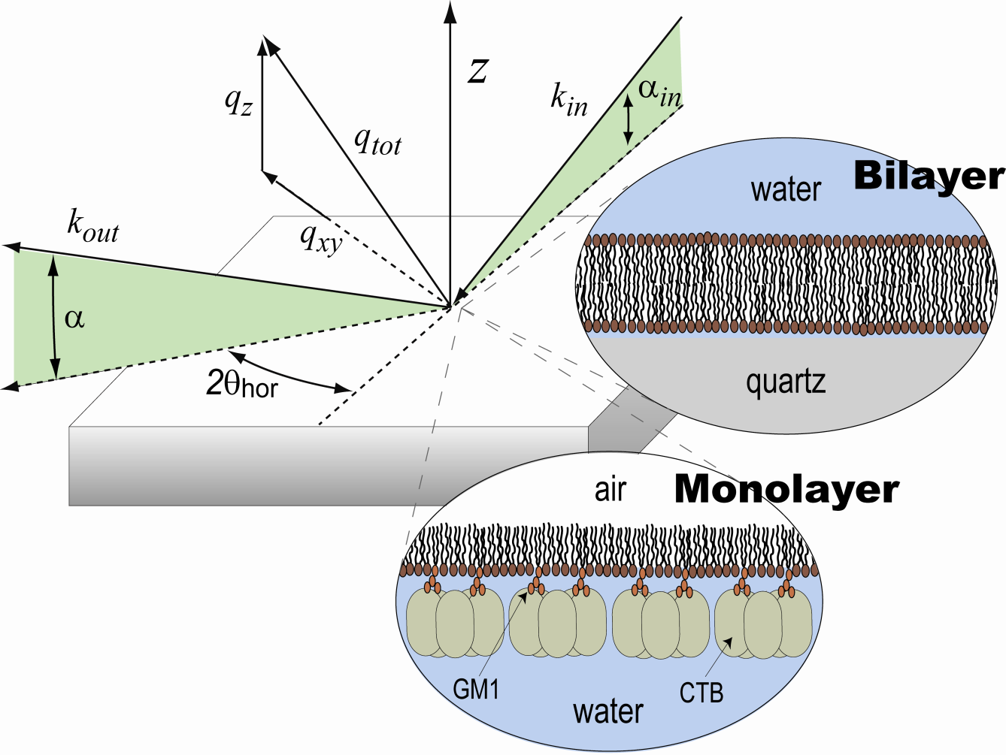
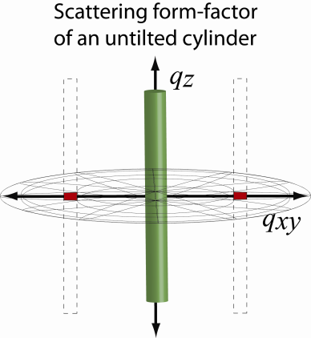
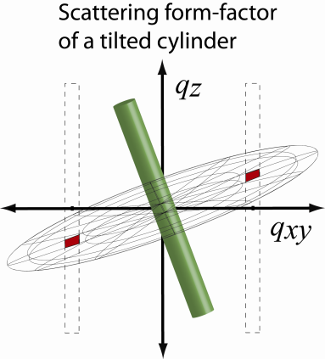
The technique…
Grazing Incidence X-ray Diffraction
Notes:
The green cylinder are the rod like molecules (lipid alkyl chain backbone).
The disk is the form factor of that shape, the dashed boxes are structure factor from the unit cell, the red blocks are where they overlap

Slide 32
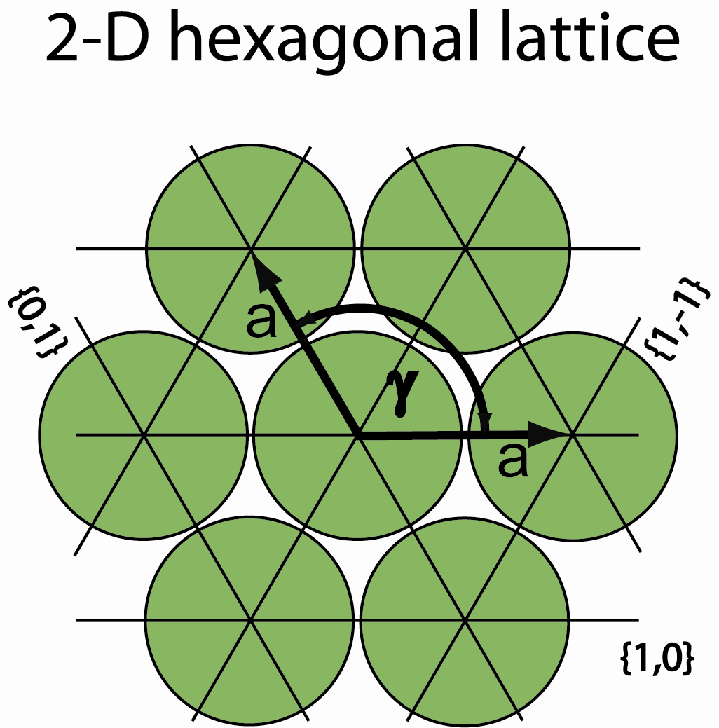
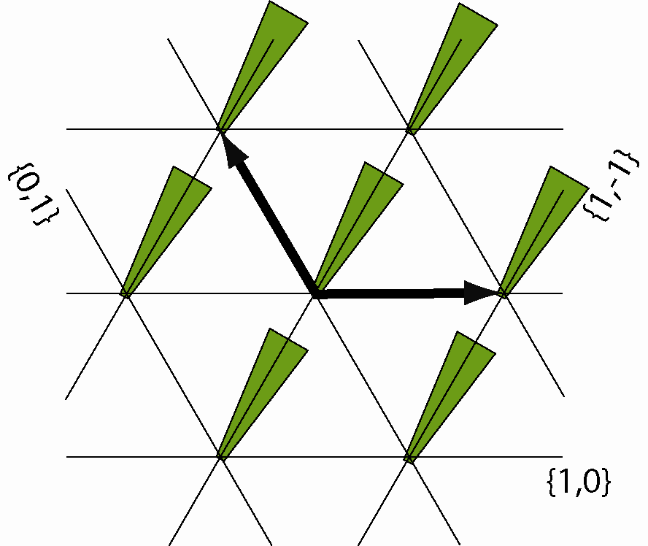
What do Bragg rods tell us?
FWHM corresponds to in-plane registry
FWHM corresponds to lipid length
DEGENERATE BRAGG PEAK
BRAGG ROD
{1,-1}
{1,0}
{0,1}
{1,0}
{0,1}
{1,-1}
TILTED
TOWARDS NN
BRAGG PEAKS
BRAGG RODS
Relationship between peak intensities: {1,0}={0,1}={1,-1}
Relationship between peak positions: qz_{max1}=qz_{max2}+qz_{max3}
Notes:
The idea here is that tilt breaks the degeneracy, splitting the Bragg peak and moving some of the Bragg rod I to higher Qz.
Peak positions correspond to the in-plane unit cell. Bragg rod I distribution can tell us about tilt.

Slide 33
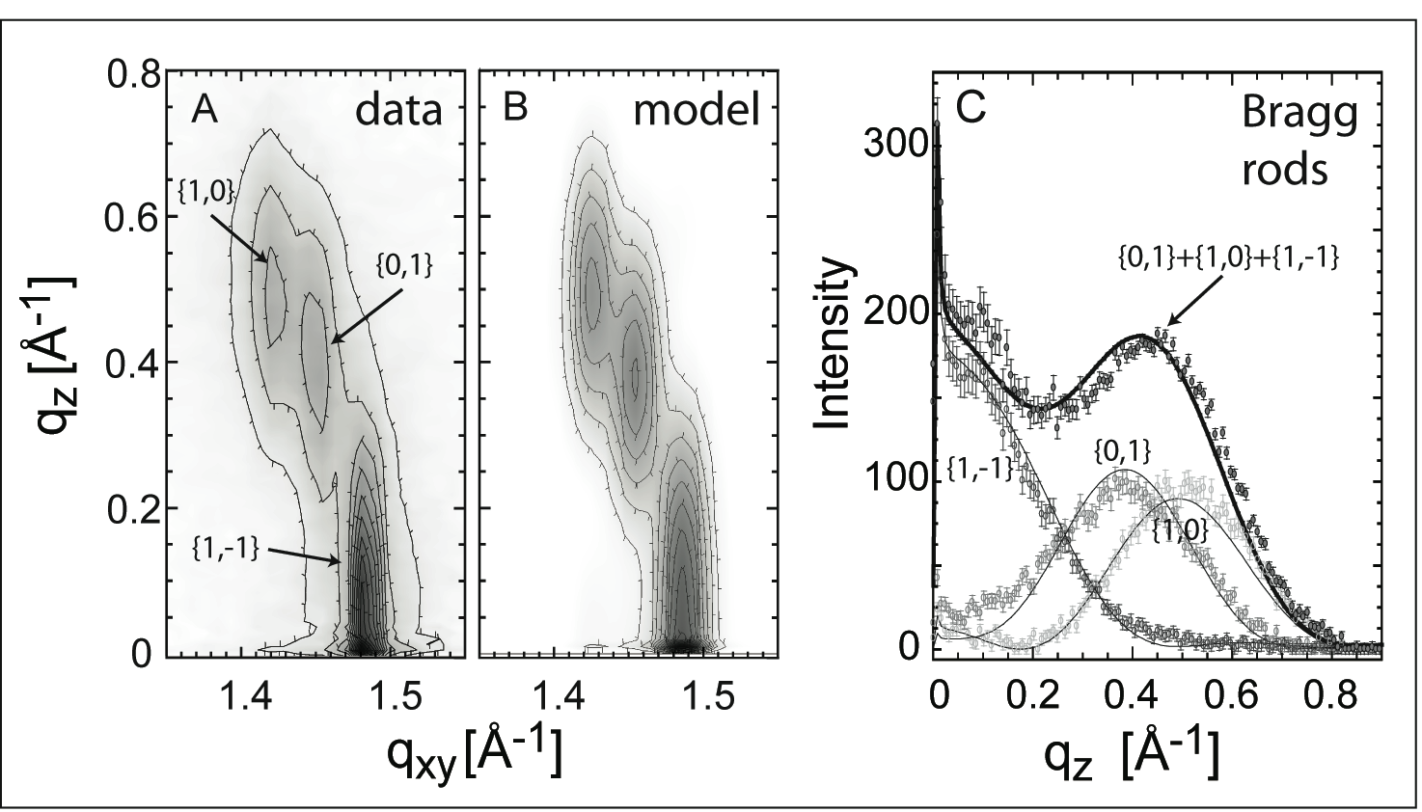
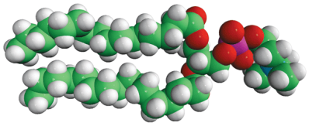
Monolayer GIXD at 20mN/m
Watkins et al., PNAS 108 (6975) 2011.
Lipid order described as close-packed rods with 21° tilt
Relationship between peak intensities: {1,0}={0,1}={1,-1}
Relationship between peak positions: qz_{max1}=qz_{max2}+qz_{max3}
Notes:
Fig. S2. Grazing incidence diffraction from 80∶20 DPPE∶GM1 monolayers at 20 mN∕mbefore CTB binding. For the unbound case, the data (A) can be modeled
(B) by calculating the diffraction from a domain of azimuthally aligned lipids. The three individual Bragg rods extracted from the model calculation match the
measured data. Model is made by defining the positions of all CH2 groups of the lipid tails for a whole domain and calculating the discrete fourier transform.

Slide 34
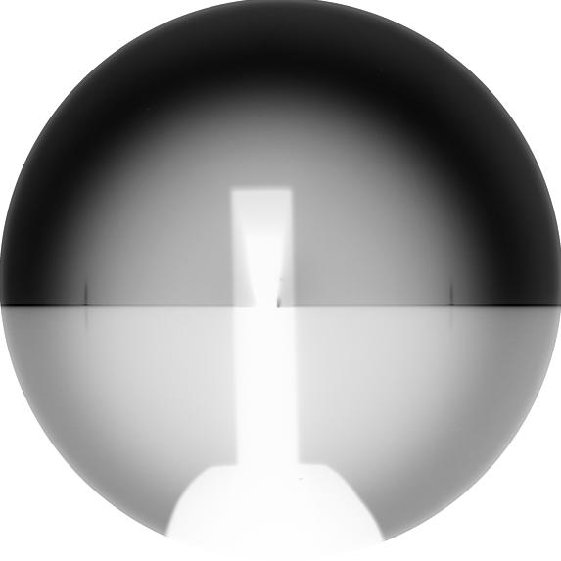
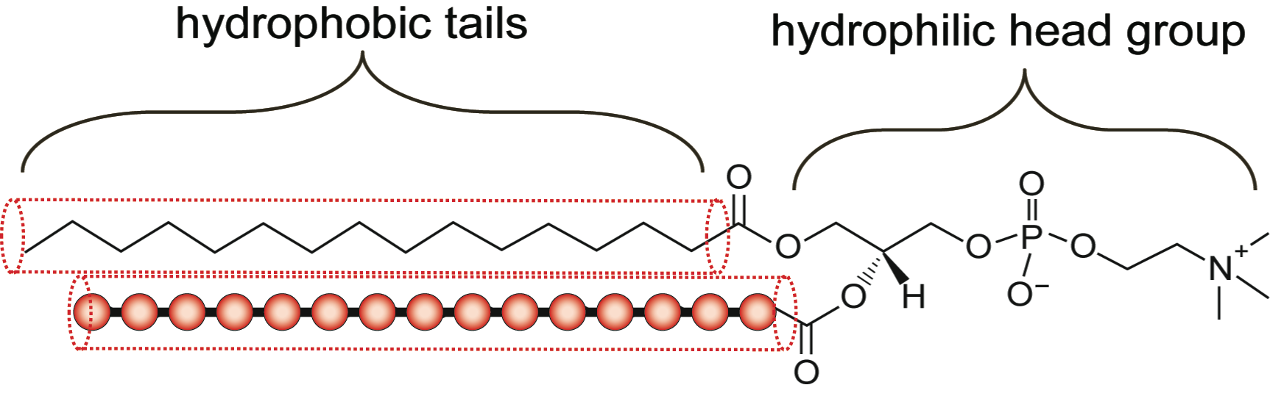
Bragg
Rods
GIXD from DPPC at the solid-liquid interface
Shadow of beam stop in center,
Shadow of quartz horizon through the middle
Dark ring is scattering from water
Highlighted diffraction is from lipids
2-D diffraction
Measures in-plane ordered structure
Lateral packing of alkyl chain (2-D unit cell)
[by position of Bragg peaks]
Chain tilt magnitude and tilt direction relative to unit cell
[by position of maxima in the Bragg rods]
Length of alkyl chain by FWHM of distribution in the Bragg rod
Lateral coherence length of the scattering domain from FWHM of the Bragg peak

Slide 35
Example V: Polyelectrolyte multilayers

Slide 36
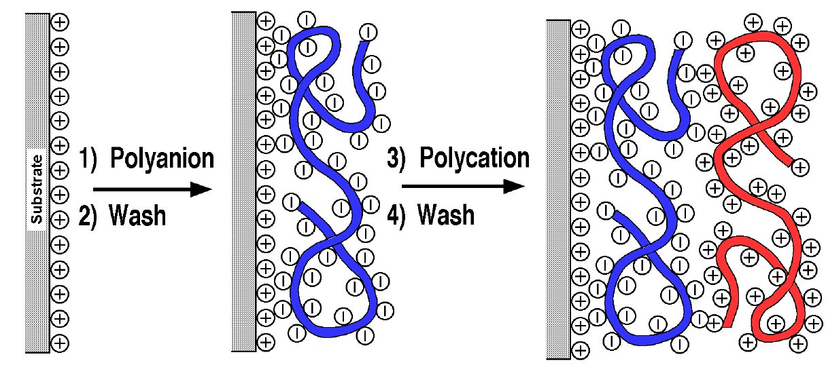
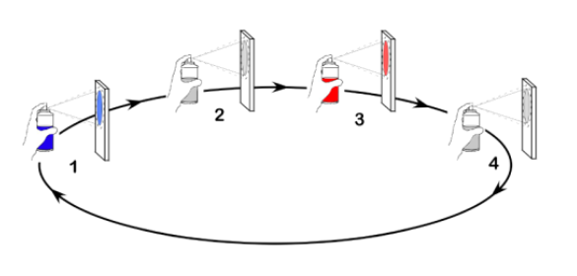
Polyelectrolyte multilayers (LbL)
Layer-by-Layer method (LbL):
Dipping:
Decher, G., Science (1997) 277, 1232-1237.
Spraying:
Easy and environment friendly production.
General applicability to organic, polymeric inorganic and biological materials.
Applications: tissue engineering, biocatalysis, electroluminescent devices, antireflective coatings, corrosion protection, ...

Slide 37
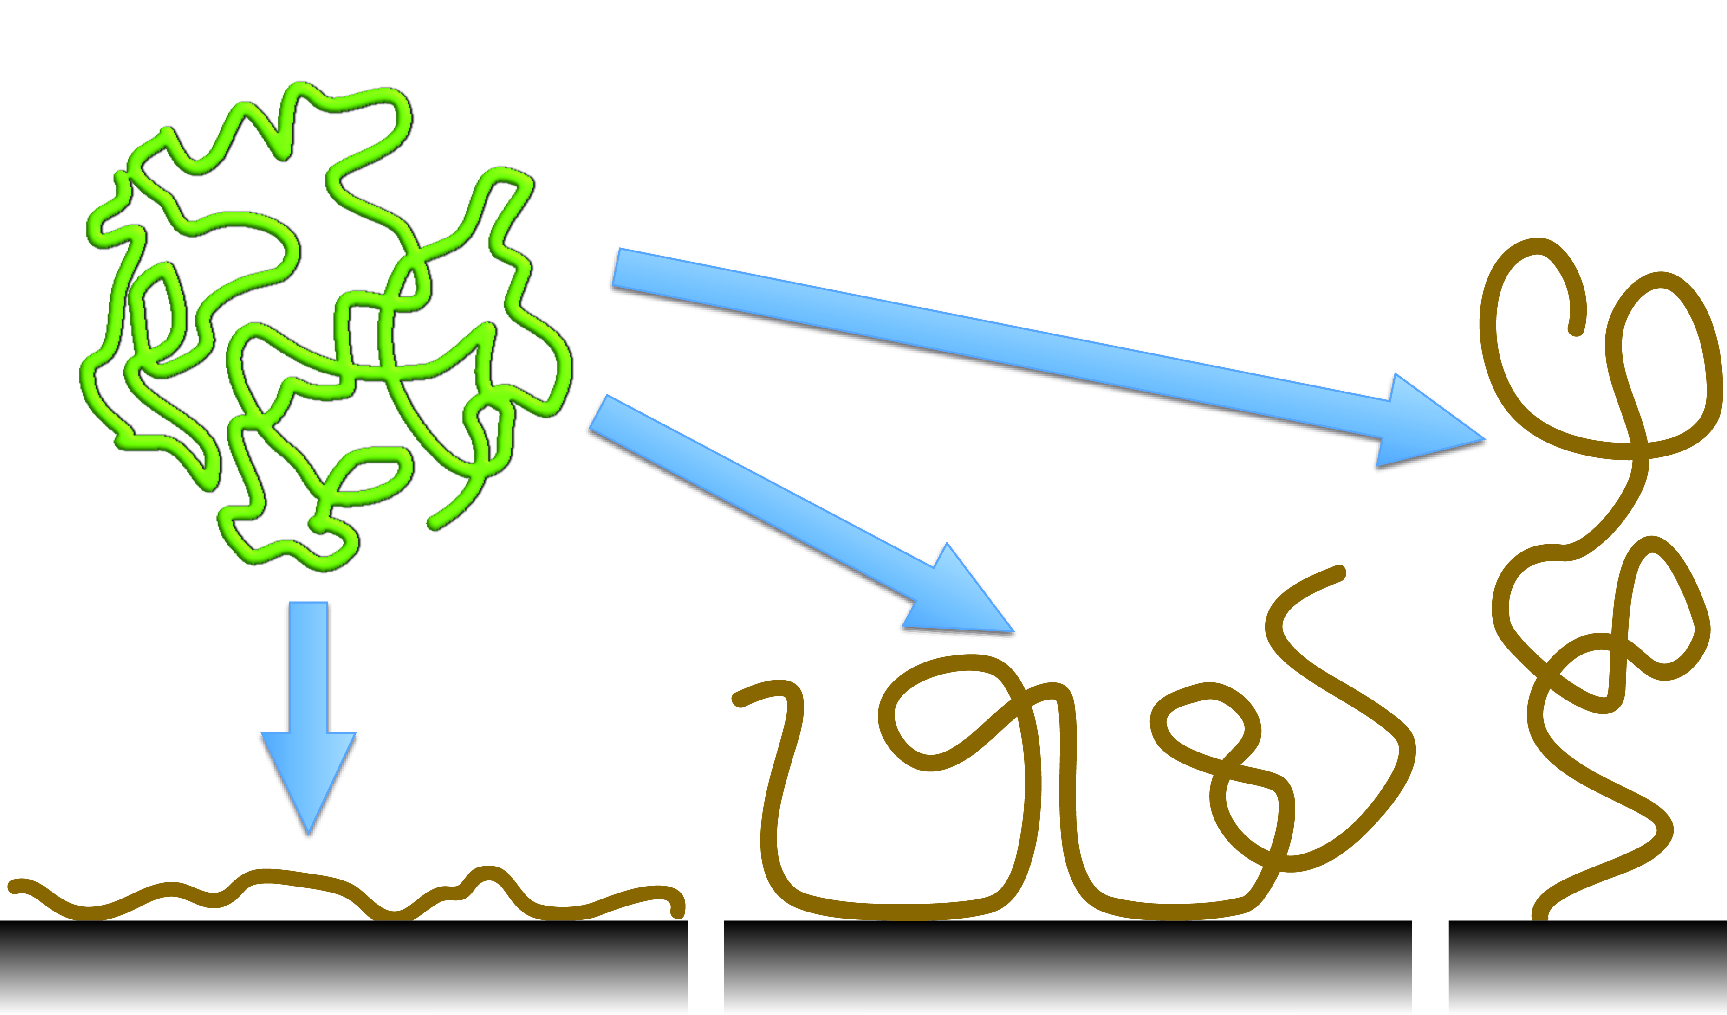
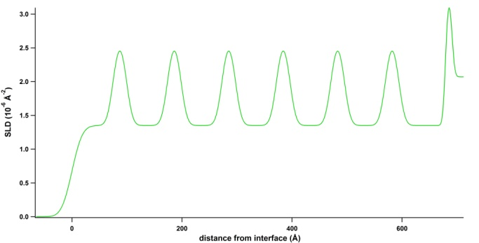
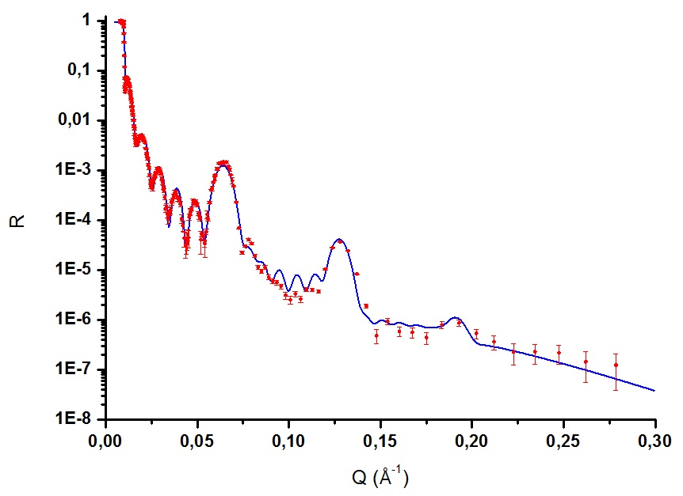
Polyelectrolyte multilayer (LbL)
C. Higy, G. Fragneto and G. Decher, Univ. Strasbourg
Layer-by-Layer method (LbL):
Polymer Conformation:
Decher, G., Science (1997) 277, 1232-1237.
Zhang, H. N., and Rühe, J., Macromolecules (2005) 38, 10743-10749.
Scattering length density profile:
Specular Neutron Reflectivity (D17):
Individual layer pair thickness: 2.4 nm

Slide 38
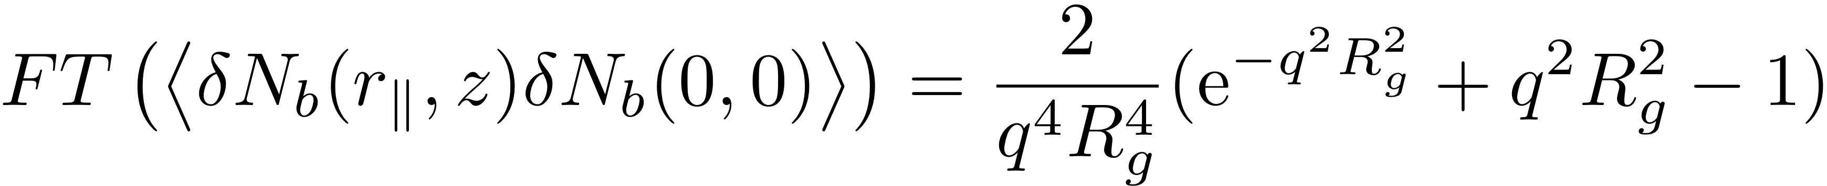
LbL
In case of symmetric in-plane disrtibution:
Mix of deuterated and protonated polymers:
(Debye Function)
Notes:
If the incident and exit angle is not changed we don’t have any influence from refraction.

Slide 39
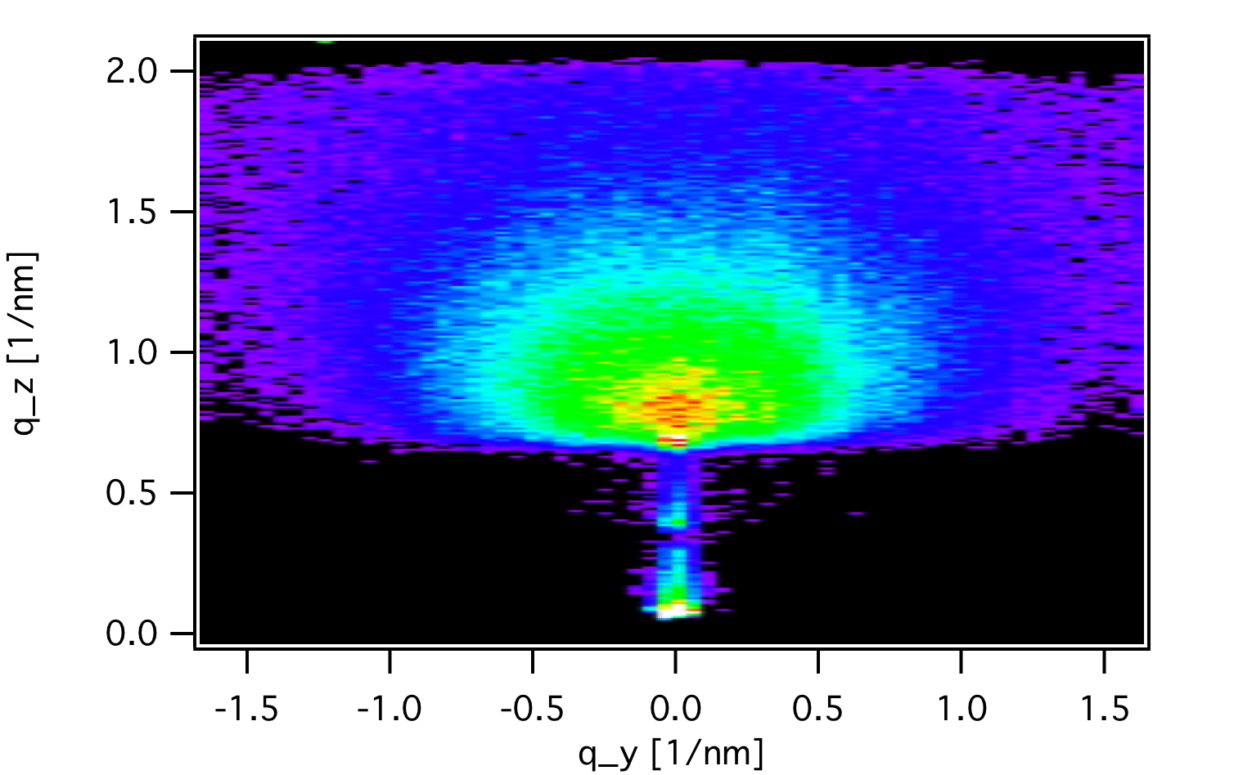

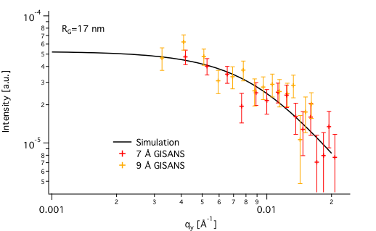
GISANS on thin polymer films
GISANS:
q_{y} cut at Yoneda peak:
GISANS reveals that the in-plane radius of gyration is 17 nm.
GISANS on polymer films give us information about:
The in-plane coil size of mixtures of labeled/unlabeled chains
The degree of interpenetration of end-labeled polymers

Slide 40
Example VI: Temperature dependent Grazing Incidence Neutron Small Angle Scattering (GISANS) on polymer micelles

Slide 41
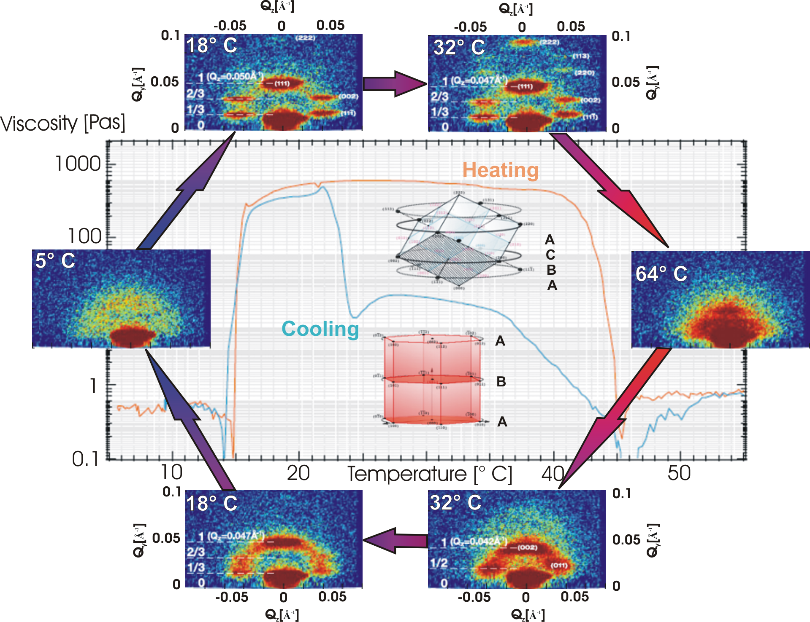
Crystallisation – P123 (30 %)
fcc
hcp
M. Wolff et al.
Hysteresis in temperature.

Slide 42
Example VII: Grazing Incident Neutron Diffraction (GIND) at the silicon/hexadecane interface?

Slide 43
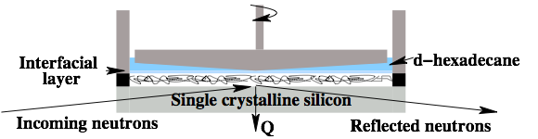

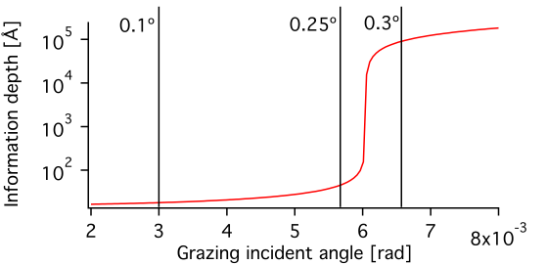


Penetration Depth
Comparison of the scattering cross sections of the materials involved:
Silicon substrate: 70*70*10 mm³
Cone diameter: 50 mm
Beam size: 40*1 mm²
For a big incident angle θi = 0.3˚
(Penetration depth 8000 Å):
For a small incident angle θi = 0.1˚
(Penetration depth 34 Å):
* L.G. Parratt , Phys. Rev. 359 (95) 1954.

Slide 44
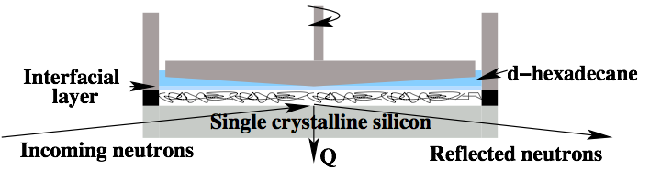
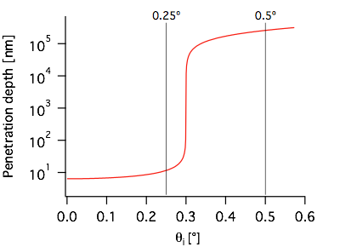


Grazing incidence neutron diffraction
Hexadecane/solid interface:
Crystal peak
Spinning cone
Silicon crystal
GIND on solid/liquid interfaces not possible yet.
Wolff et al., J. Phys: Cond. Matt. 23 (184102) 2011.

Slide 45
References
M. Wolff, A. Magerl, H. Zabel, The European Physical Journal E. vol. 16, no. 2, pp.141-145, 2005
J. Daillant, A. Gibauld eds., X-Ray and Neutron Reflectivity – Principles and Applications. Vol 770 Springer, 2009

