Slide 1

Contrast Variation in elastic
Neutron Scattering
At small angles
Philipp Gutfreund
ILL, Grenoble, France
gutfreund@ill.eu
Uppsala University, October 6, 2020

Slide 2
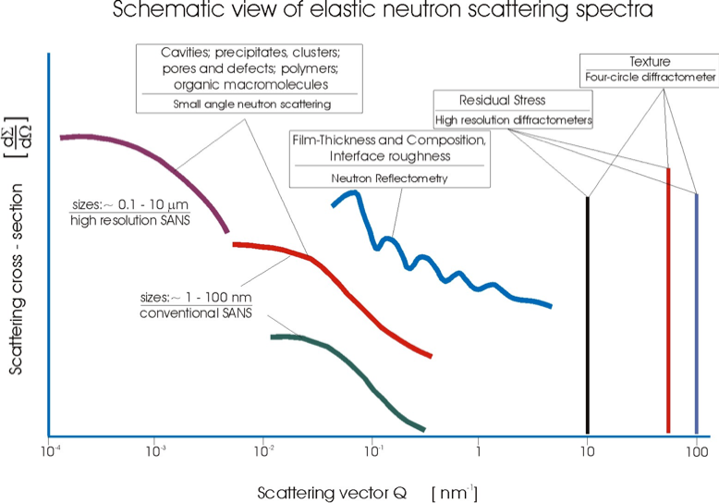
_________________________________
Giovanna Fragneto HERCULES 2012

Slide 3
Outline
  Fundamental Scattering Theory
  Small Angle Neutron Scattering (SANS)
  Reflection of Neutrons at small angles (NR)
  NR Instrumentation and Data Reduction
  NR Data analysis + Practical (start at 13:30)

Slide 4
1. Fundamental Scattering Theory

Slide 5
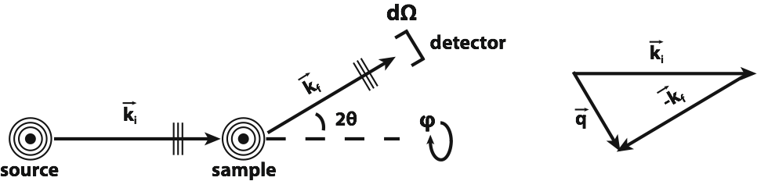



Elastic differential cross section
No inelastic scattering considered:
Out of the direct beam:
Alternative:
Fermi’s golden rule:
Notes:
The quantity measured in a scattering experiment is the differential cross section.
If we build the absolute square of the probability function and ignore cross terms of the direct and scattered beams (no multiple scattering) we end up with the absolute square of the scattering function as the resulting cross section out of the direct beam.

Slide 6
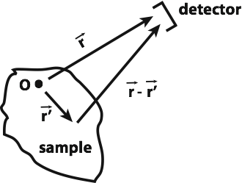
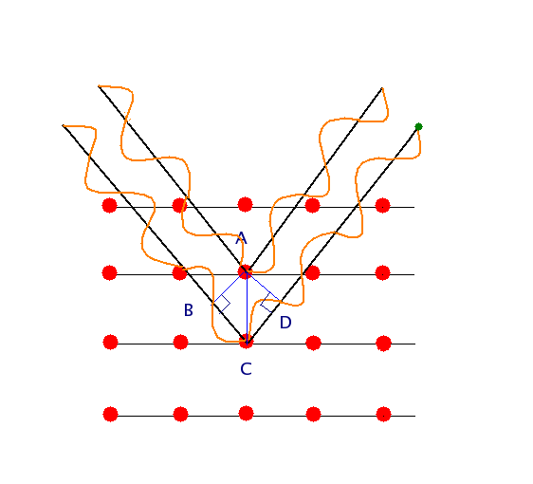



1st order Born Approximation
Inhomogeneous Helmholtz equation:
Ansatz:
Scattering function:
Assumptions:
Wave is the same inside and outside of the sample (kinematic approximation)
Interaction potential is small (perturbation theory)
Single scattering event (1st order)
Neutron and X-ray scattering on a potential much smaller than the wavelength results in radial waves!
Notes:
The wave vector in the Angstrom range, the interaction potential is in the fm range, thus small. Common between neutrons and X-rays is the wavelength. The scattering function is the Fourier transformation of the potential V.

Slide 7
2nd order Born Approximation?
Scattering function f⁽²⁾ (for particles):

Slide 8
Potential V(r) for a single nucleus
Cold neutron wavelengths on Å length scale
Scattering on nuclei (strong interaction) of fm size
Point scattering
Scattering function:
Scattering Function of a single nucleus is described by a single number!
Definition of scattering length b:
Fermi pseudo potential:
Notes:
Scattering on a single point.

Slide 9
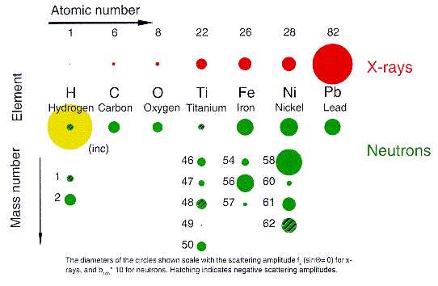
Scattering cross sections for neutrons and X-rays
Origins of scattering differ for the different methods.
X-rays dominated by number of electrons:
Neutrons rely on contrast of nucleus: similar for many different elements, but show strong variations from different isotopes of same element, especially hydrogen.

Slide 10
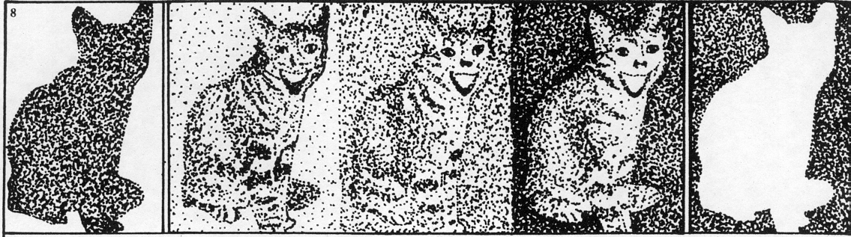
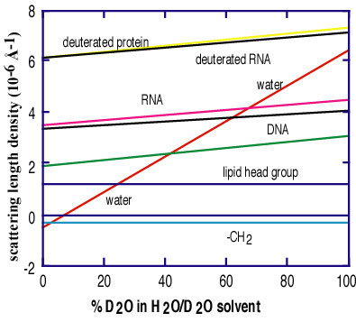

Slide 11
Neutron-matter interaction
Neutrons only see the magnetization perpendicular to the scattering vector!
Interaction neutron-nucleus
  Isotropic and ponctual
Zeeman interaction
  Neutron spin – magnetic field
Neutron-nucleus
Neutron-magnetic field
Neutron-magnetisation
nuclear magneton
permeability
g-factor
Pauli spin matrix
Notes:
The Fourier-transformed magnetization of the sample M|| is the component in-plane of the surface (for NR) (but perpendicular to q)!

Slide 12
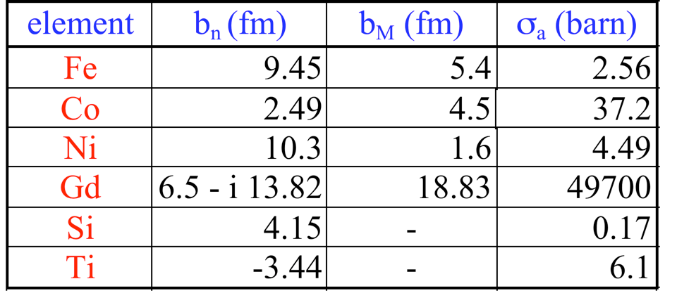
Comparison nuclear and magnetic neutron scattering lengths.

Slide 13
Spin scattering
Fermi Golden rule:
Pure nuclear scattering:
Nuclear scattering is entirely non-spin-flip.
Non-spin-flip scattering is sensitive to magnetization parallel to neutron spin.
Spin-flip scattering is sensitive to magnetization perpendicular to neutron spin.
Notes:
If we do the calculations we see that the spin incoherent scattering adds with a factor of 1/3 to the total incoherent scattering. (R. Stuart script)

Slide 14
Coherent/Incoherent Scattering
Spin-incoherence:
Probability
Neutron Spin:
Neutron+
(random) nucleus spin:
Average (coherent) scattering length:
Strandard variation (incoherent) scattering length:
Same for natural distribution of isotopes (isotope incoherence)
Total cross section:

Slide 15
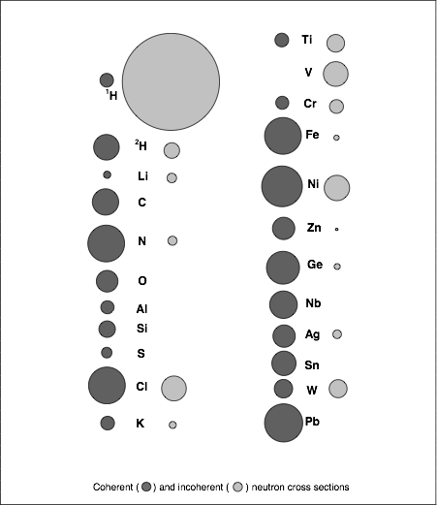
Neutron Scattering Cross Sections
Scattering at nuclei
Typical Wavelengths (cold neutrons) 2 Å - 30 Å
No charge, thus deeply penetrating matter
Possible contrast tuning by exchanging isotopes, especially Protons with Deuterons
Notes:
Some elements like oxygen have no incoherent scattering due to the absence of a nuclear spin and isotopes.

Slide 16
2. Small Angle Neutron Scattering (SANS)
Porcar et al.

Slide 17
Applications of SAS
● colloidal suspensions
● polymers:
chains, blends , block copolymers
● surfactant assemblies
● biological molecules:
proteins, nucleic acids, complexes, small bio-related molecules
● surface properties of catalysts
● metal physics:
phase stability of alloys, precipitates, interfaces, grain boundaries
● materials science:
structural tailoring and testing, stability under load
● nanocrystalline materials:
grain size, interface, porosity, magnetic nanostructures
● flux lines in superconductors

Slide 18
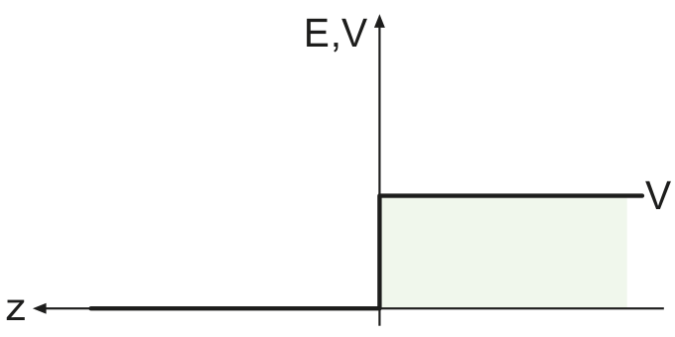
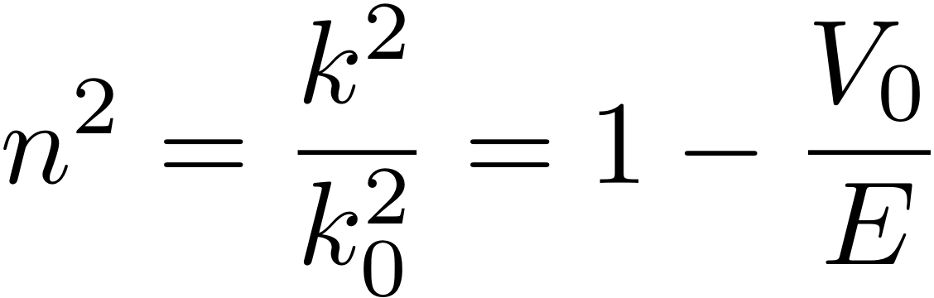
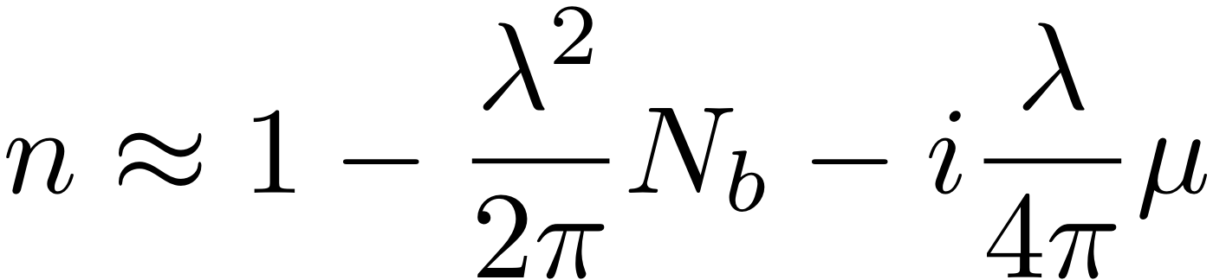
Scattering length density
Neutron, X-rays and light scattering at small angles
can be described by the scattering on an optical potential!
For small angle scattering the positions of individual atoms are not resolved,
Therefore the mean scattering length density (SLD) N_{b} is seen:
Optical refractive index:
SLD
SLD:
N_{b} = ρ₀*b
Absorption coefficient
Neutrons:
X-rays:
Notes:
But, the refractive index is smaller than 1 in most cases: Total external reflection!
The SLD is wavelength independent. Show imaginary SLD. Uebung: n Selber ausrechen (Doktorarbeit S.28).

Slide 19
Scattering Function from an assembly of particles
The scattered intensity per unit volume V of an assembly of isotropic scatterers of individual volume Vp and volume fraction Φ is:
Volume fraction
of particles
Particle form factor
Volume of individual
particle
Particle structure factor
Difference of length scattering density
between particle and solvent
Notes:
The convolution theorem FT( int f(x)g(x-x1) dx)=FT(g(q))*FT(f(g)). Thus we can factorize the structure and form factors.

Slide 20
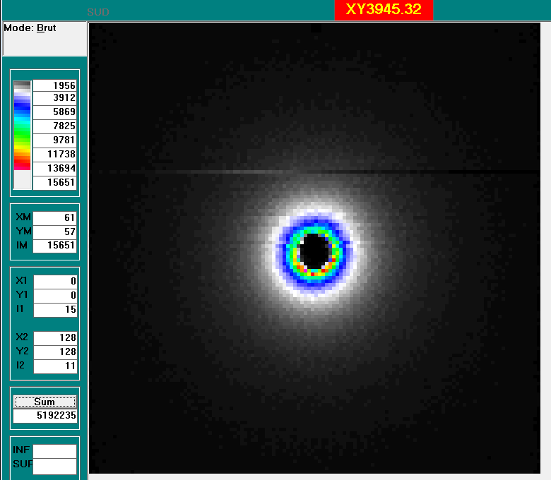
Scattering from Polymer melts
SANS from mixture of deuterated and protonated polymers:
Debye function
Fraction of deuterated molecules
Polymerization
Monomer volume
Isotropic scattering
SLD difference between deuterated and protonated monomers
1/R_{G}
With deuteration SANS can see individual polymer chains in an entangled melt!
Kawecki et al., Sci. Rep., 9, 1-6 (2019).
PDMS melt
Notes:
Scattering on an assembly of points. I show a structure factor of a liquid here, as an example.

Slide 21






Scattering Function for Polymers
Diffracted Intensity from N particles:
Scattered intensity proportional to FT of the Auto-correlation!
For Gaussian chains this the Debye function.
Auto-correlation function (Patterson function)
D.G.H. Ballard et al., Eur. Polymer J. 9, 965 (1973)
For Gaussian polymers:
R.G. Kirste & W.A. Kruse, Polymer 16, 120 (1975)
Debye function:
Radius of gyration:
Notes:
Scattering on an assembly of points. I show a structure factor of a liquid here, as an example.

Slide 22
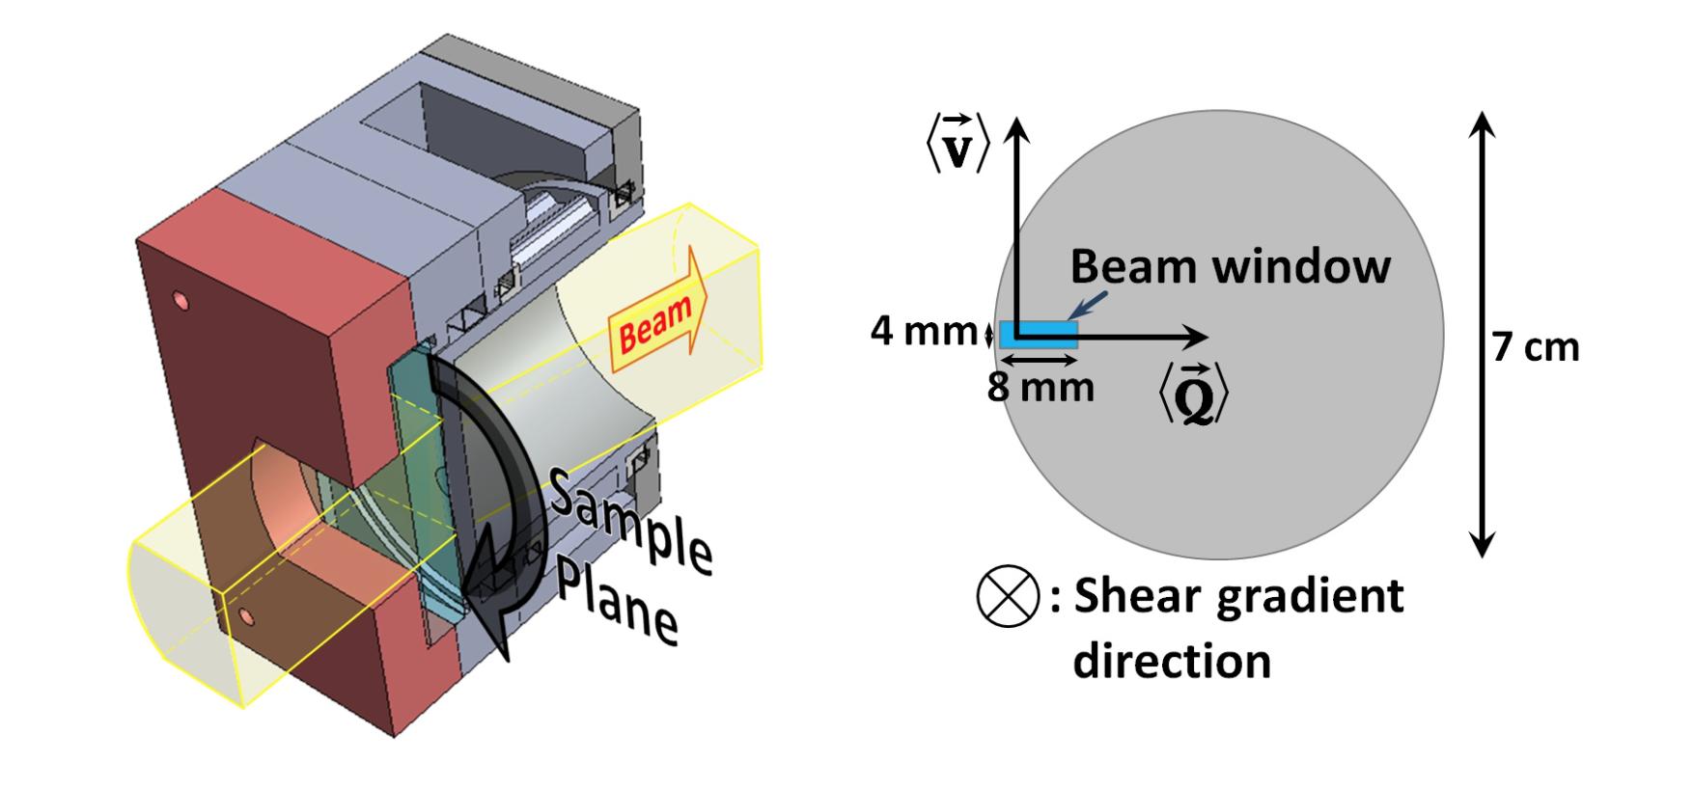
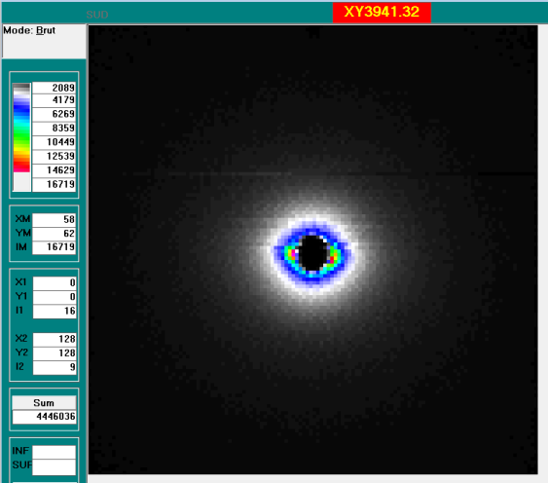
Do chains in solution deform under shear?
Yes, they elongate along the flow (slightly)
30 wt% Polystyrene (PS M_{n}=520 kg/mol) in d-toluene:
Wi = 210 s⁻¹ * 0.14 s = 30
Wi * N_{e}/N = 30 / 10 = 3
At PAXY/LLB
R_{g∥}/R_{g⟂} = 1.07
flow direction
static
shear
Korolkovas et al., Soft Matter, 15, 371 (2019).
neutral direction y
Anisotropic scattering

Slide 23
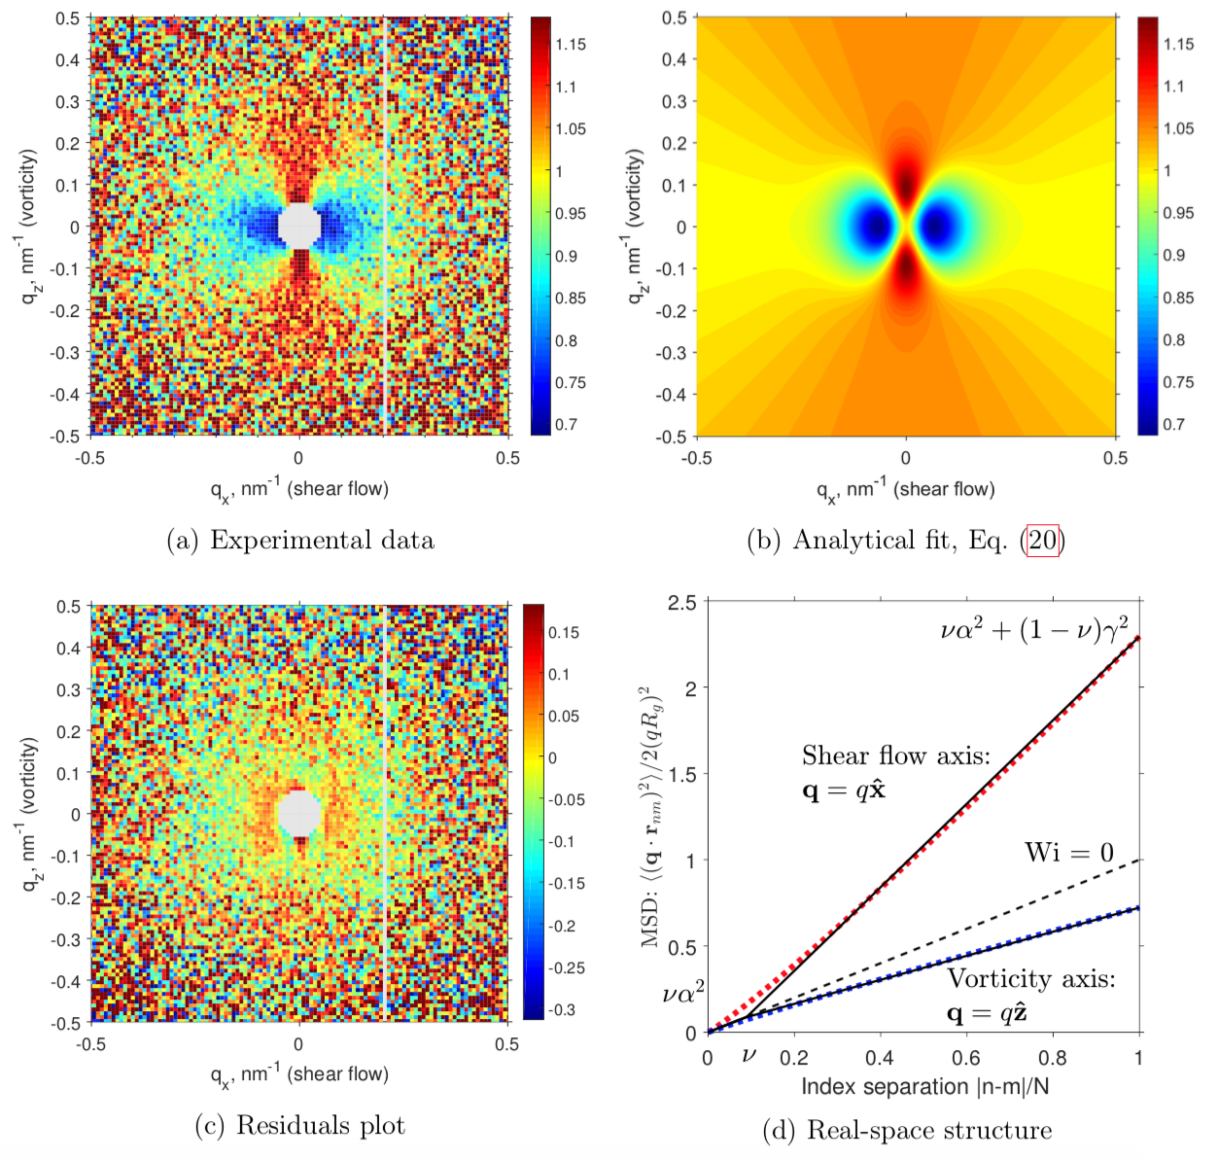
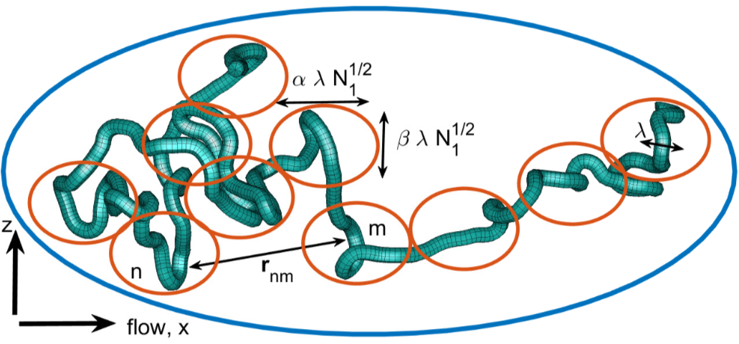
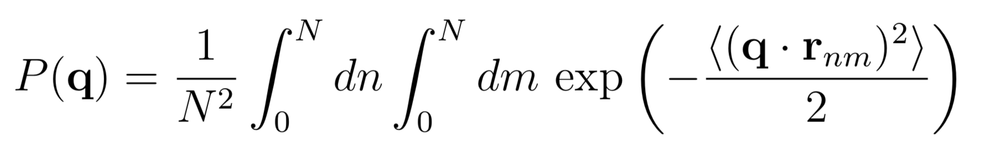
Do chains in solution deform under shear?
Single chain form factor:
MSD
(Eq. 20)
The deformation is non-affine below 8 nm at Wi=30. (Blob size 1nm, R_{g}=27 nm)
This is roughly the tube diameter!
Korolkovas et al., Soft Matter, 15, 371 (2019).

Slide 24
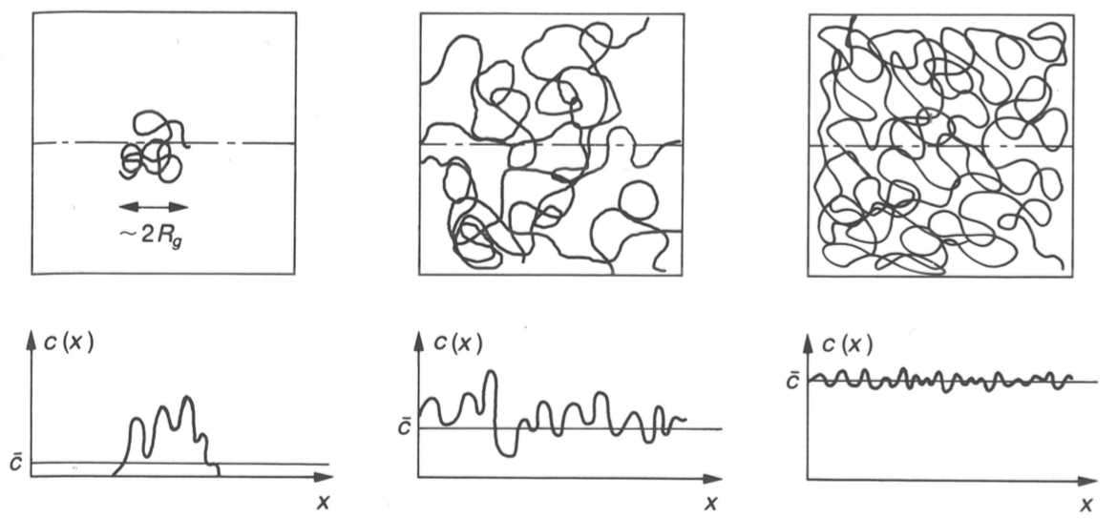
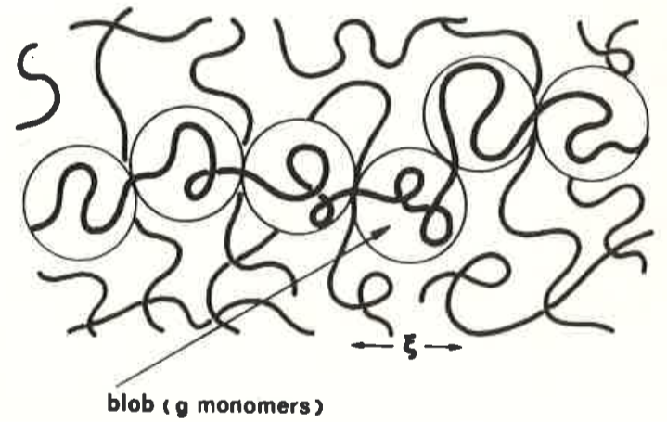
Coarse-grained polymer solution
concentration c and molecular weight M_{w}
Number of blobs
Blob size
Contrast between polymers
Average contrast of the solution
De Gennes Scaling concepts in polymer physics. Cornell university press, 1979.
Doi & Edwards The Theory of Polymer Dynamics. Oxford university press, 1989.

Slide 25
General behaviour of a scattering curve
Case of a dilute solution of uncorrelated particles
log(I)
1.3/R_{G}
q^{-n}
n=1: cylinder, 1D
n=2: disk, 2D
Molecular mass
Concentration
Δρ²
Guinier
range
(radius of gyration)
Guinier analysis
(model independent):
Local structure
Interface
(q⁻⁴)
Slope = R_{G}² / 3
2π/d
log(q)
Analytical expressions for spheres, cylinders, ellipsoids, disks, muli-shell particles, Gaussian coils, …

Slide 26
Analytical expressions of form factors
Sphere
Multi-shell
Disk/cylinder
Ellipsoid

Slide 27
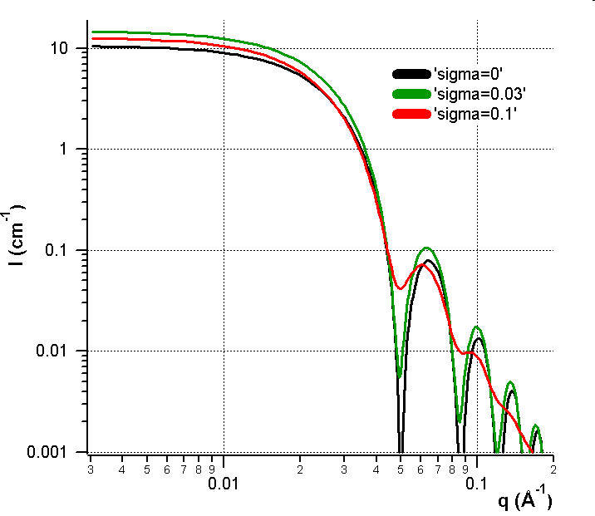
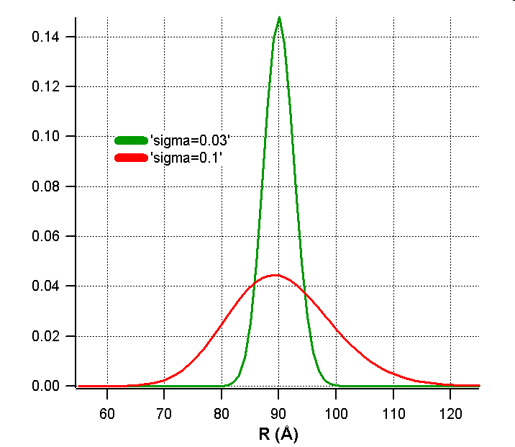
Polydispersity
Case of polydisperse spherical particles without interaction
Log-normal distribution
R = 90 Å

Slide 28
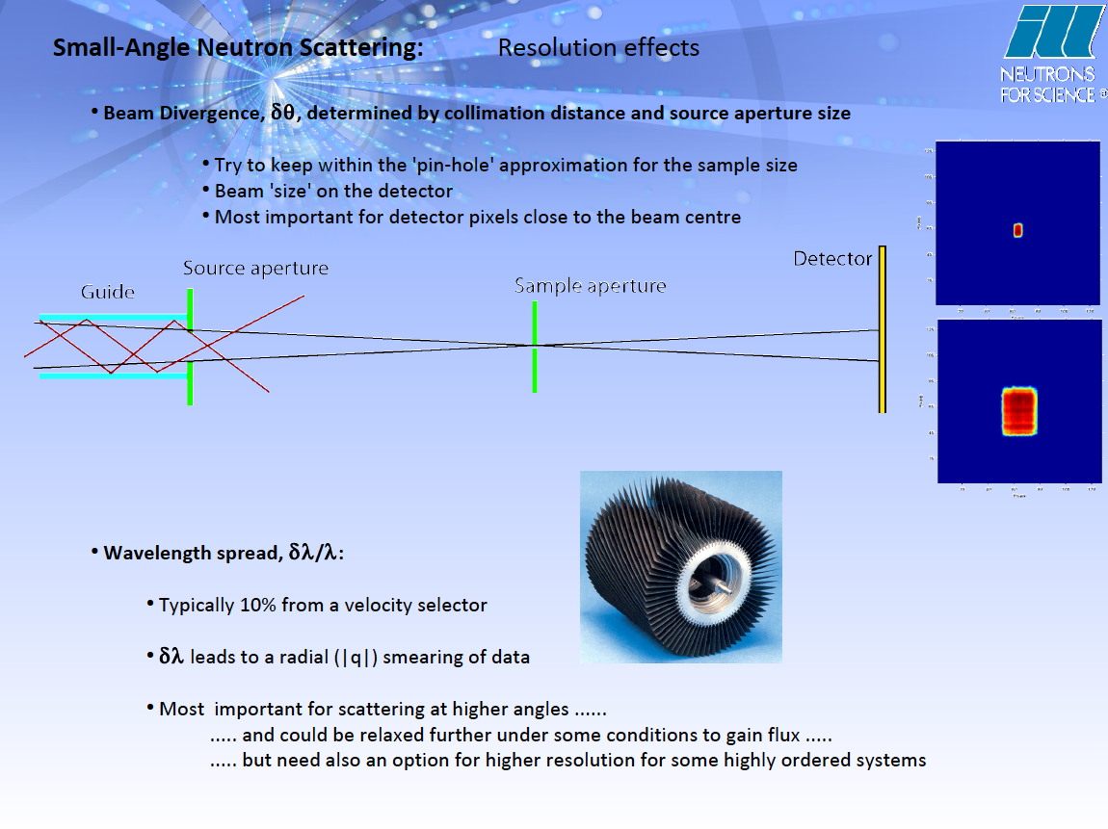

Slide 29
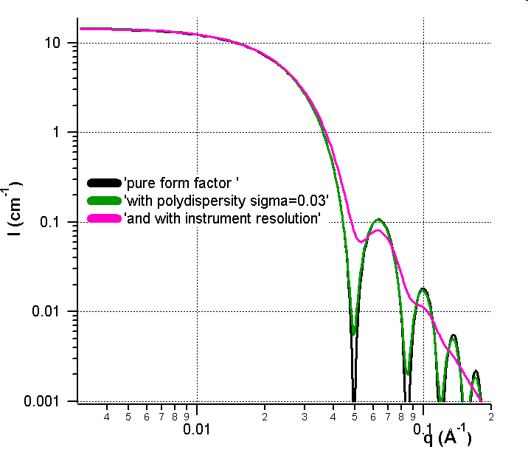
Combined effect of polydispersity and resolution
Favor the resolution rather than the flux
Importance of the instrumental resolution in the data treatment
More details… Effect of instrumental resolution and polydispersity on ideal form factor in SANS, I. Grillo, ILL Technical Report, 2001, ILL01GR08T

Slide 30
Summary
(
)
∫
∞
(
)
⎡
∫
∞
(
)
(
)
⎤
I
q
,
r
=
R
q
,
q
,
Δ
q
G
r
,
r
,
σ
S (q)
exp
o
o
o
o
⎢
o
P
r
,
q
dr
⎥
dq
0
⎣
0
⎦
Instrument resolution
Form Factor
Pedersen (Adv. Colloid Interface Sci. 1997, 70, 171)
Nallet et al.( J. Phys. II France, 1993, 3, 487)
Structure Factor
Percus-Yevick (Phys. Rev. 1958, 110, 1 )
Hayter-Penfold (Mol. Phys. 1981 42,109)
Polydispersity in size
(log-normal distribution)

Slide 31
Break 15 min

Slide 32
2. Small Angle Neutron Scattering (SANS)
Applications

Slide 33
SAS techniques
Small angle neutron scattering
PAXY, Laboratoire Léon Brillouin, Saclay
λ = 12 Å, D = 5 m λ = 4 Å, D = 5 m and 1 m 0.0047 < q (Å⁻¹) < 0.45
Probe the size and polydispersity of liposomes

Slide 34
Size and shape of the liposomes
Pure liposome
DOTAP/DOPE = 4.2 10⁻² mol/l
Charged liposome
DOTAP/DOPE = 4.2 10⁻² mol/l
X LCOB =0.5
10⁴
10²
I (cm⁻¹)
1
10⁻²
10⁻⁴
0.001
0.01
0.1
q (Å⁻¹)
1
t_{c} = 24.0 Å
t_{h} = 10.0 Å
e = 44.0 Å
R_{o} = 459 Å
s = 0.18 Å
ρ_{c,n} = 2.61 10⁹ cm⁻²
ρ_{h,n} =5.46 10¹⁰ cm⁻²
t_{c} = 26.0 Å
t_{h} = 5.4 Å
e = 38.8 Å
R_{o} = 445 Å
σ = 0.13 Å
ρ_{c,n} = -1.29 10⁹ cm⁻²
ρ_{h,n} =3.5 10¹⁰ cm⁻²

Slide 35
In-situ transfer by Time-Resolved SANS
Advantages:
H₂O
D₂O
Cholesterol
+ D-lipids
H-lipids
D-lipids
H-lipids
Do not require vesicles isolation (in situ technique)
No need of fluorescent or tag cholesterol
Access early stage of transfer
Accurate control on lipid membrane composition and structure
Can be applied to anything (just require deuterated materials)
t = 0
t = inf
Cholesterol Exchange
Lipid Exchange
Arenas et al., Sci. Rep., 7, 45875 (2017).

Slide 36
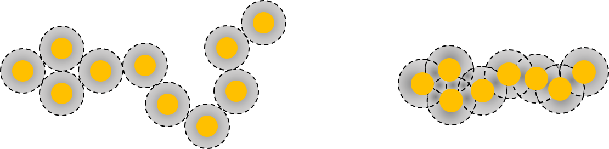
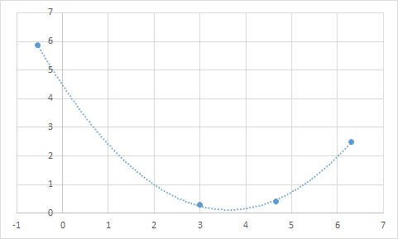
Functionalized Gold Nanospheres
PSS
+ PEDOT
50%
water
D₂O
AuMW
ZAC
H2O
Au
≈3 nm
24.2 nm
Low-q intensity [a.u.]
SLDs:
D₂O = 6.3 * 10⁻⁶ Å⁻²
AuMW = 4.66 * 10⁻⁶ Å⁻²
ZAC = 3 * 10⁻⁶ Å⁻²
PSS/PEDOT = 2 * 10⁻⁶ Å⁻²
H₂O = -0.57* 10⁻⁶ Å⁻²
Contrast SLD [* 10⁻⁶ Å⁻²]

Slide 37
Materials and method
OR
TEOS silica precursor : Si-(RO)₄
RO
Si
OR
R= -CH₂CH₃
Hydrolysis and condensation
OR
P123
EO₂₀PO₇₀EO₂₀
EO = -CH₂-CH₂-O-
PO = -CH₂-CH(CH₃)-O-
ρ₀
ρ₀
ρ₁
ρ₁
ρ₂
ρ₂
ρ(r)
ρ(r)
Neutron
RX

Slide 38
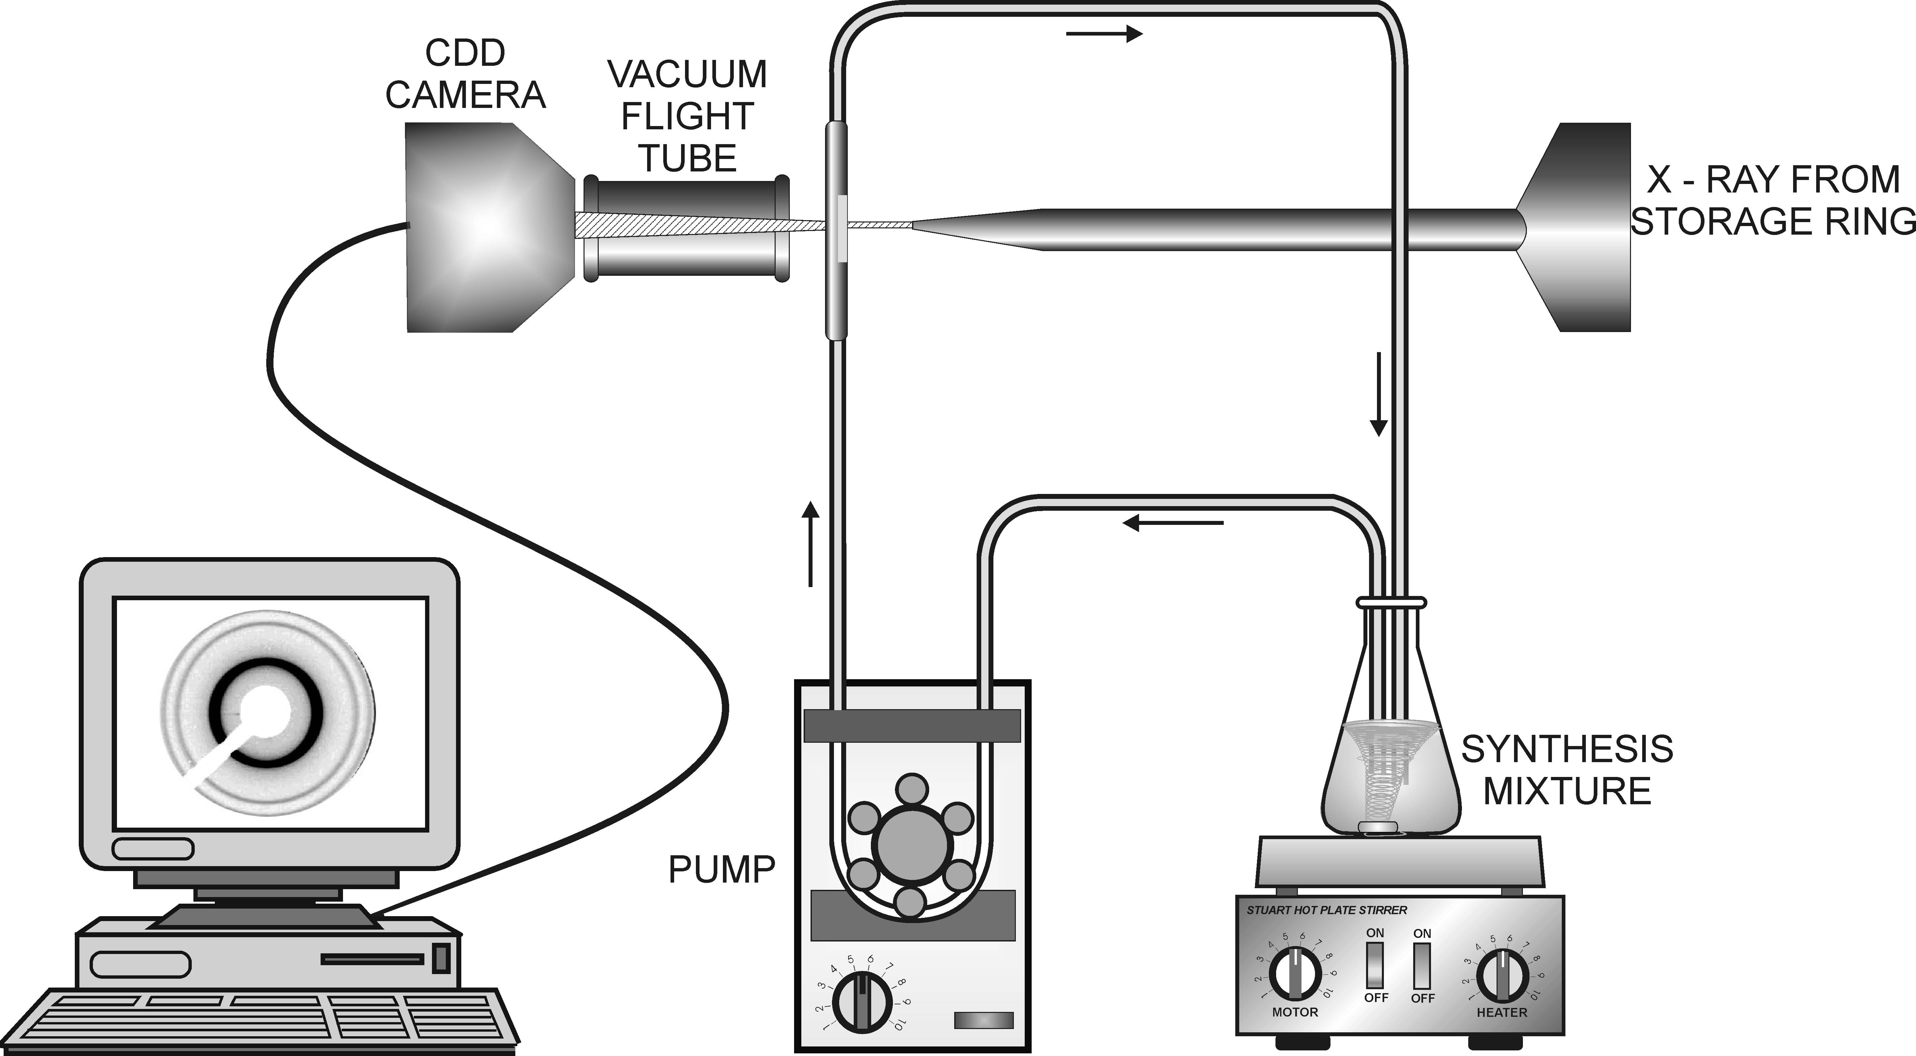
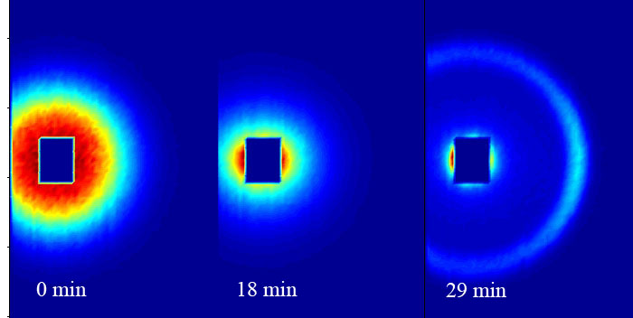
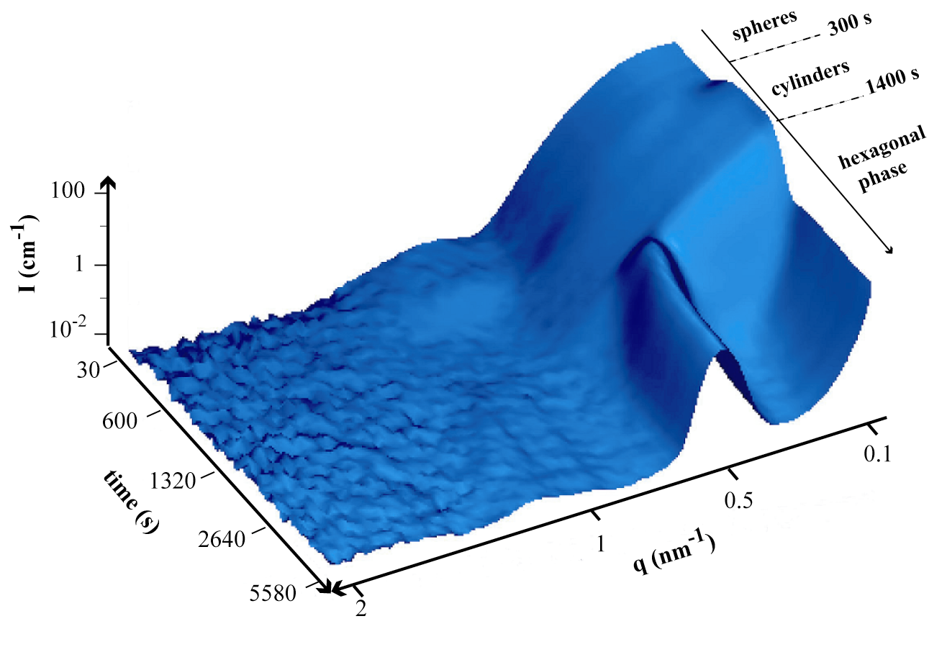
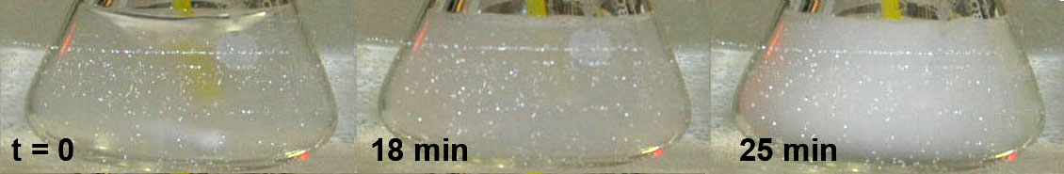
Micellar solution
Precipitation after 22 min

Slide 39
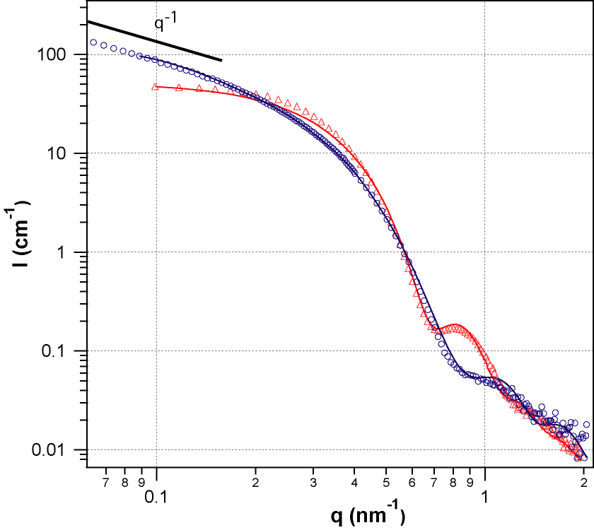
Evolution of the micellar shape before precipitation
Core-shell models for sphere and cylinder
F(q,R) is the form factor of a sphere or cylinder
Spherical micelles before TEOS addition
R₂ = 4 nm, R₁ = 7.1 nm and β = 0.26.
Cylindrical micelles after 15 minutes
R₂ = 2.9 nm, R₁ = 6.9 nm, L = 22 nm and β = 0.4

Slide 40
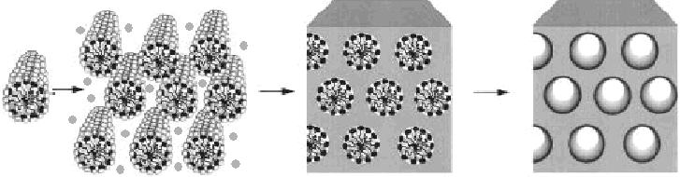
In-situ study of the synthesis of mesoporous materials
¹M. Imperor-Clerc, ²I. Grillo, ³A.Y. khodakov, ⁴D. Durand, ⁵V.L. Zholobenko
Chem. Commun. 2007 (8) 834-836
¹ LPS, Université Paris Sud, Orsay, F;² I.L.L, F; ³ UCCS, Université des Sciences et technologies de Lille, F; ⁴ IBBMC, Université Paris-Sud, F; ⁵ Dpt of Chemistry, Keele, UK
surfactant + silica
solution oligomers
hybrid material
calcination (400°C)
Catalysis supports, filtration membranes, surface treatment (glass industry), confinement of liquids …
Nano-particles inside the porosity :(metallic, metallic oxydes, semiconductors)
New material properties : optical, magnetic …

Slide 41
Usefull references
Theory
● A. Guinier, G, Fournet (1955) Small angle scattering of x–rays. Wiley, New York
● H. B. Stuhrmann, J. Appl. Cryst (1974), 7, 173-178
● Neutron, X-rays and Light: Scattering Methods applied to soft condensed Matter, ed. P. Lindner and T. Zemb, Elsevier, 2002,
● D. Lairez, J. Peta J. Phys IV, 130 (2005) 39-62
Model and data analysis
● O. Glatter, Acta Phys. Austriaca (1977), 47, 83-102, J. Appl. Cryst. (1977),10, 415-421; J. Appl. Cryst. (1980),13, 7-11
● D. I. Svergun, M.H.J. Koch, Rep. Prog. Phys. (2003), 66, 1735-1782
● J.B. Hayter, J. Penfold, Molecular Physics (1981), 42, 109-118
● J. Pedersen Adv. Colloid Interface Sci. (1997), 70, 171-210
Google NIST SANS tutorials + SANS Toolbox (B.Hammouda)!!

Slide 42
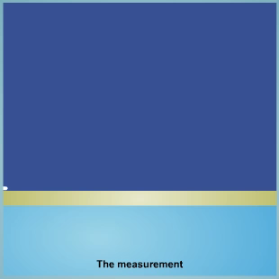
3. Small Angle Reflectometry

Slide 43
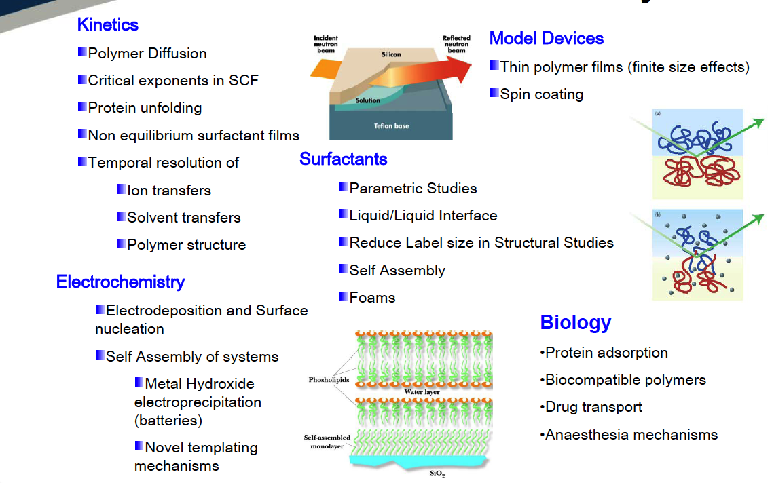
Applications of Neutron Reflectometry
Layer-by-Layer
Magentism: Magneitc multilayers, Thin magnetic films, Thin film magnetometry

Slide 44
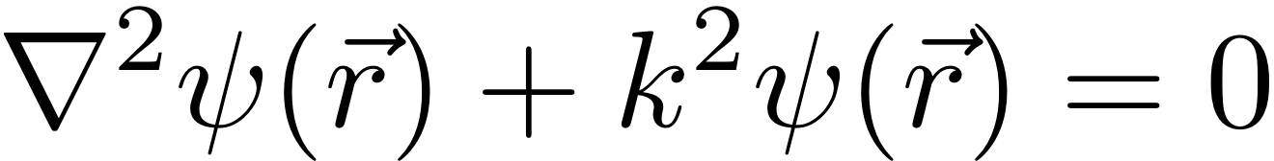
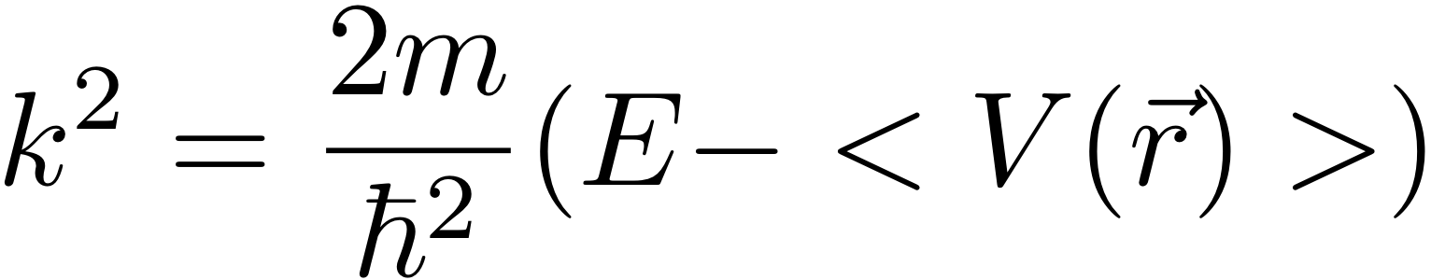
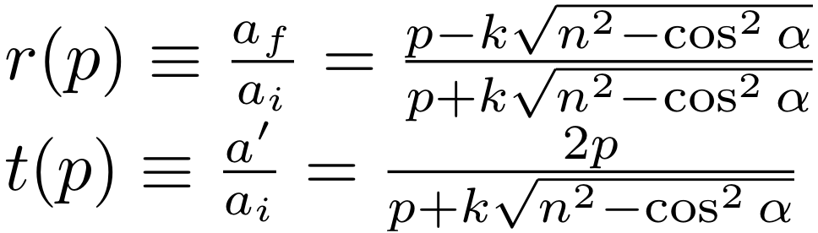
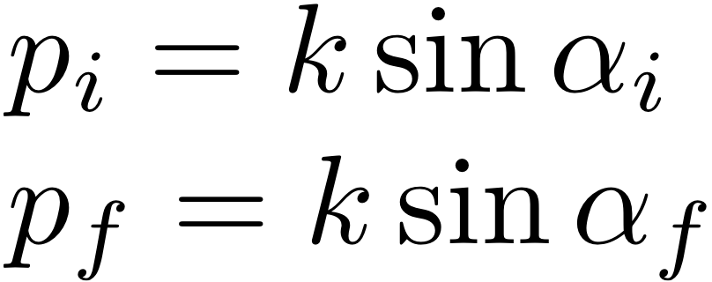
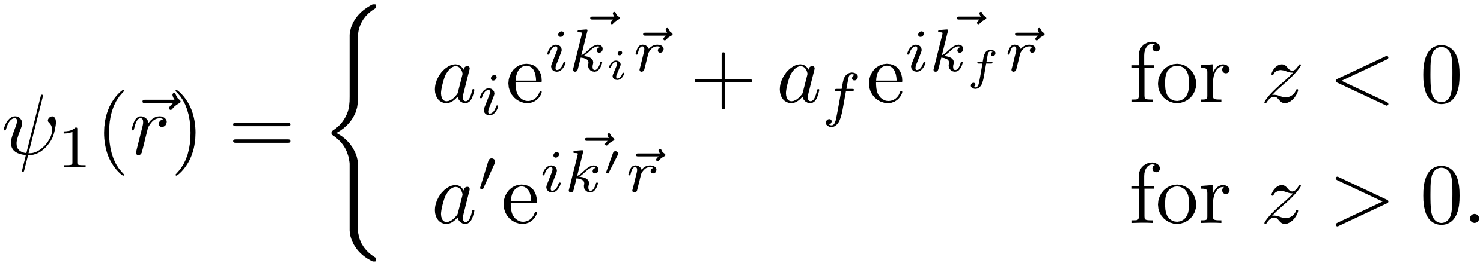
Exact solution of step potential (QM)
Helmholtz equation:
Fresnel functions:
Complete Solution:
Notes:
We can completely solve this problem and calculate the transmission functions of the incoming and reflected waves.
Here I used the z-axis projection.

Slide 45
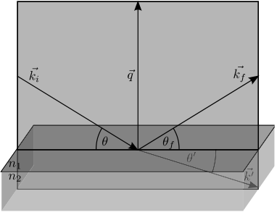

Reflectometry (Optics)
Fresnel:
Snellius:
Total Reflection :
For an ideal smooth interface (Fresnel-reflectivity):
For q >> q_{c}:

Slide 46
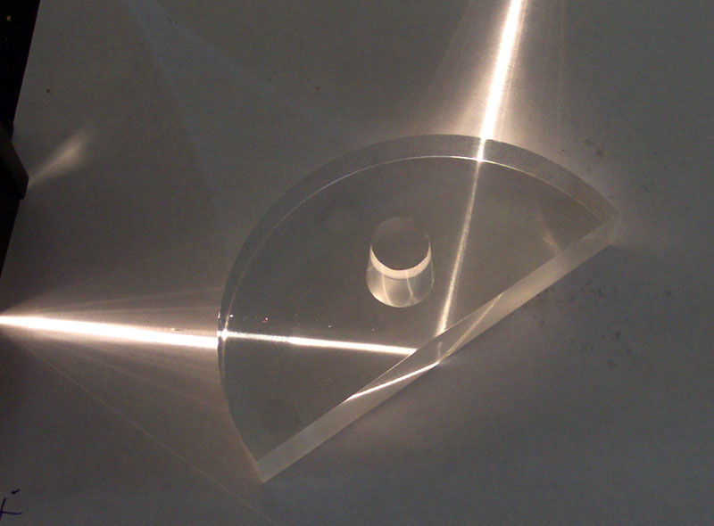
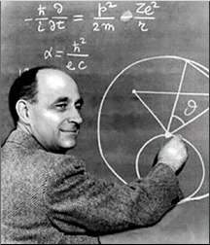
Total Reflection
For both kinds of radiation the refractive index is a function of the scattering length density and wavelength.
Total Reflection of neutrons was first observed in 1944 by Fermi and Zinn (Phys. Rev. 70, 103 (1946))
As with light, total reflection may occur when neutrons pass from a medium of higher refractive index to one of lower refractive index.

Slide 47
Roughness
  Roughness at the molecular level : interdiffusion between the layers, x < 10 nm.
  Intermediate roughness
  (0.01 µm < x < 50 µm).
  A large scale roughness
  (beam size > x > 50 µm).

Slide 48
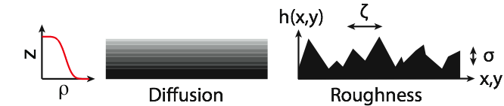
Roughness
In the Born approximation (validity: |σq_{z}|<<1):
Gaussian roughness:
Nevot-Croce:
Born approximation:
Exact optical solution
(no in-plane correlation):
L.G. Parratt, Phys. Rev. 95, 359 (1954).
Névot and Croce, Revue Phys. Appl. 15, 761 (1980).
Notes:
Nevot-Croce for uncorrelated molecular/atomic roughness.

Slide 49
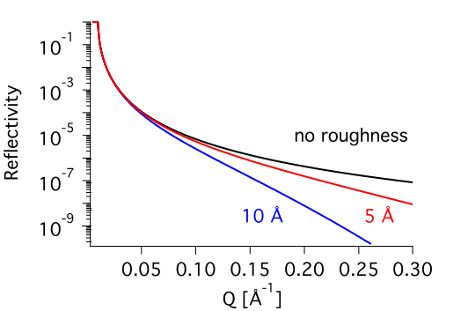
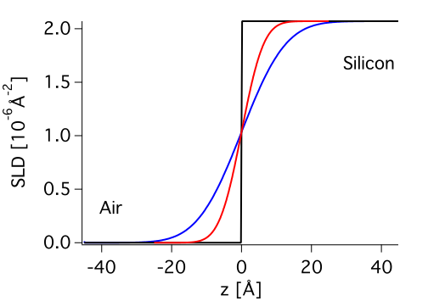
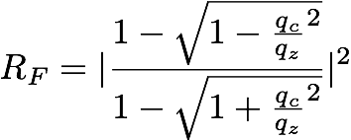
The Fresnel reflectivity + Roughness
For an ideal smooth interface:
For roughness σ:
Notes:
This results in the exact Reflectivity as Emanuel told us yesterday.

Slide 50
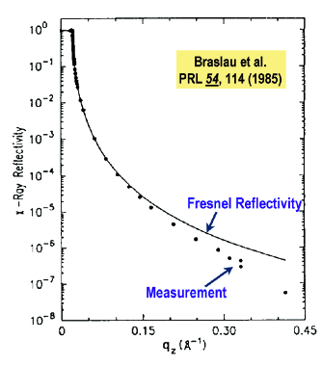

The Fresnel reflectivity + Roughness
For an ideal smooth interface:
X-ray reflection from
free water surface
For qz » qc :
Deviation due to capillary waves!

Slide 51
Stratified Medium (Matrix method)
Refraction matrix
(Through continuity
at interfaces):
F. Abelès, J. de Physique et le Radium 11, 307 (1950).

Slide 52
Stratified Medium (Matrix method)
Transition matrix:
Transfer matrix:
Notes:
We can completely solve this problem and calculate the transmission functions of the incoming and reflected waves.
Here I used the z-axis projection.

Slide 53
Stratified Medium (Matrix method)
reflection coefficient:
If subphase is sufficiently thick (>0.1 mm):

Slide 54
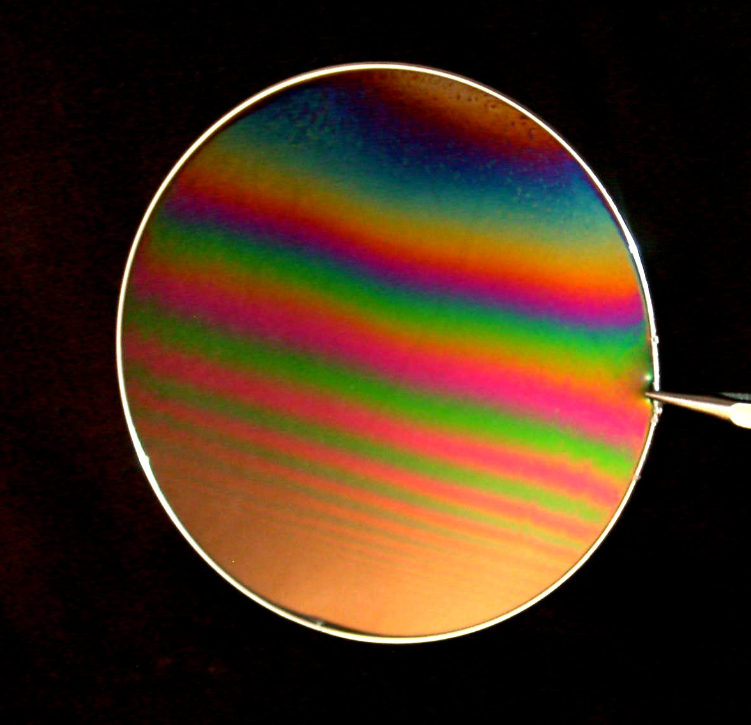

Interference
The neutrons are partially reflected and transmitted:
k₁
k₁
k_{i}
ρ₀
θ₀
θ₀
θ₀
ρ₁
θ₁
ρ₂
θ₂
k₂
1675 - Newton realised that the colour of the light reflected by a thin film illuminated by a parallel beam of white light could be used to obtain a measure of the film thickness. Spectral colours develop as a result of interference between light reflected from the front and back surfaces of the film.
1931 - H. Kiessig measures the total external reflection of X-rays and the thickness interference oscillations named after him. (Ann. d. Physik 402, 715)

Slide 55
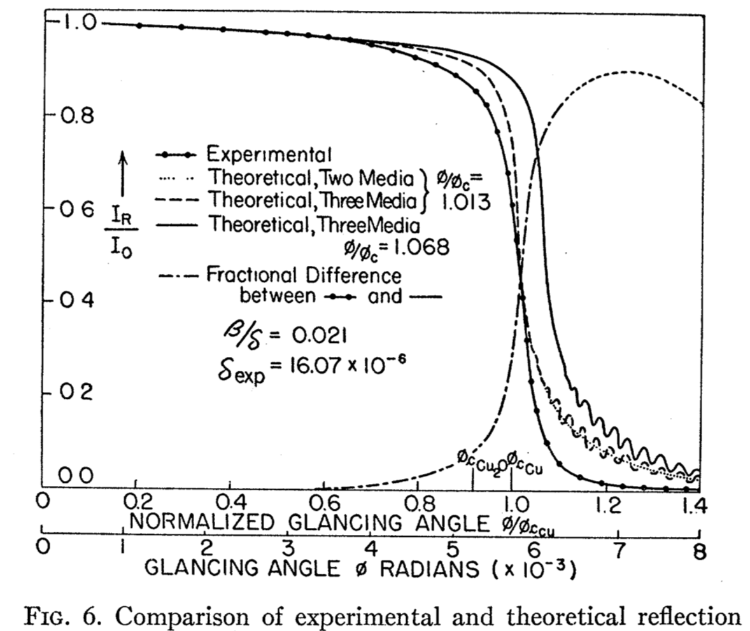
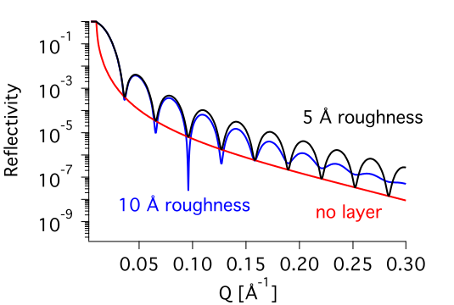

Reflectometry from stratified media
Recursively calculating the reflected and transmitted intensity via Fresnel adding the Debye-Waller roughness leads to the reflectivity of layered systems.
L.G. Parratt, Phys. Rev. 95, 359 (1954).

Slide 56
Reflectometry from stratified media
2π/d

Slide 57
Break 15 min

Slide 58
3. Small Angle Reflectometry
Applications

Slide 59


Model Cell Membranes

Slide 60

Reflectometry
Log R
Neutron wavelength << light wavelength
nanothin films e.g. lipid membranes (~ 5nm)
Optical Matrix modeling
liquid = D₂O/H₂O
D₂O
z
Solid = Si-SiO₂
SiO₂
Model structure of lipid membrane
= layered model of structure & composition
Scattering length density profile ρ(z)
= neutron refractive index profile

Slide 61


Reflectometry
ρ(z)
ρ
h-lipid
Log R
d-lipid
thickness
z
liquid = D₂O/H₂O
D₂O
z
Solid = Si-SiO₂
SiO₂
Model structure of lipid membrane
= layered model of structure & composition
Scattering length density profile ρ(z)
= neutron refractive index profile
Notes:
The contrast between the water phase (D2O) and the lipid bilayer can be tuned by (partially) deuterating the lipid.

Slide 62
Reflectometry
ρ(z)
ρ
h-lipid
Log R
d-lipid
thickness
z
liquid = D₂O
D₂O
z
Solid = Si-SiO₂
SiO₂
Model structure of lipid membrane
= layered model of structure & composition
Scattering length density profile ρ(z)
= neutron refractive index profile

Slide 63
Reflectometry
ρ(z)
ρ
h-lipid
Log R
d-lipid
thickness
z
liquid = H₂O
D₂O
z
z
Solid = Si-SiO₂
SiO₂
Model structure of lipid membrane
= layered model of structure & composition
Scattering length density profile ρ(z)
= neutron refractive index profile

Slide 64





SAMPLE ENVIRONMENT
Solid/liquid cell for adsorption on surfaces
Humidity chamber

Slide 65



GM1 enters the membrane
Cholesterol goes in the inner leaflet
_________________________________
Giovanna Fragneto HERCULES 2012
Notes:
GM1 (monosialotetrahexosylganglioside) studies have indicated that GM1 can ease the symptoms of Parkinson's disease

Slide 66



SAMPLE ENVIRONMENT
Adsorption troughs for adsorption from solution
Langmuir trough for insoluble monolayers

Slide 67



PERSPECTIVES:
fast kinetics
10s
2˚
PLA₂ has a delay of 1.5h before hydrolysis begins
Monolayer s2 tructure at 2.0° measured in min – 20s possible.
PLA₂ hydrolyses ~ 50% of d54DMPC monolayer and remains attached to it
Courtesy H. Wacklin
Courtesy Hanna Wacklin
Notes:
Phospholipases A2 (PLA2s) are enzymes that cleave fatty acid (phospholipids) hydrolyzing the bond

Slide 68





Co-polymer Langmuir monolayers
Structure of hydrophobic (polybutadiene)/ hydrophilic (cellulose acetate) polymer blend at the air/water interface.
PBd/CA
Nb_{PBd} = 5.72.10⁻⁶ Å⁻² Nb_{CA} = 1.23.10⁻⁶ Å⁻²
Barriers
PBd
Water contrast-matched
to CA/BP mixture
water

Slide 69






Polymer brush under shear
d-PS in DEP
Grafted h-PS
Grafting-to PS brush
M_{w} = 82 kg/mol
surface coverage = 0.16
Korolkovas et al., Macromolecules 50 (1215) 2017.

Slide 70
Monomer density profile of ‘grafted from’ brush
Phase diagram of brushes in a melt matrix:
Dry brush!
Same, but larger interfacial width.
(300 Å)

Slide 71
Flowing polystyrene on ‘grafted from’ brush
Phase diagram of brushes in a melt matrix:
dry brush
wet brush (parabolic density profile)!

Slide 72




Thin polystyrene films on SAMs
Results:
An atomically smooth interface has emerged in the contacting PS.
A depletion layer has to be assumed:
Gutfreund et al., Phys. Rev. E 87 (12306) 2013.
DTS: 4.2 ± 0.14 Å
OTS: 6.8 ± 0.08 Å
same density

Slide 73

Thin polystyrene films on SAMs
What is the chemical composition of the depletion layer?
Neutron Reflectivity: deuterated PS on protonated SAM
The depletion layer incorporates a part of the SAM and the Polymer
The amount of deuterated and protonated material corresponds very well to the assumption of the phenyl ring ordering
OTS interface layer consists of:
66 ± 4 % PS and 11 ± 3 % silane
DTS interface layer consists of:
32 ± 12 % PS and 43 ± 12 % silane.
Gutfreund et al., Phys. Rev. E 87 (12306) 2013.
Depletion layer is the result of an altered interfacial order.
Surface order is replicated in the adjacent polymer melt. (Reason for Slip?!)

Slide 74


Watching thermoresponsive hydrogel take up water
Proronated poly(styrene-block-monomethoxydiethylenglycol-acrylate-block-styrene) (P(S-b-MDEGA-b-S)) films +D2O -huge contrast
Macromolecules zhong et. al.
46 4069 (2013)

Slide 75
Experimental set-up
Guide field
polariser
flipper
sample
flipper
analyser
detector
4 cross-sections
+
+
-
B
-
+
-
-
+
M

Slide 76
Polarized Reflectivity
For magnetization and external field (+neutron spin) parallel:
No spin-flip scattering
++ and -- reflections identical to non-magnetic reflectivity but with shifted critical edge according to magnetic scattering length

Slide 77
Polarized Reflectivity
Notes:
Show Zabarkshs data for perpendicular q B realtion

Slide 78
Polarized Reflectivity
In case of an arbitrary angle γ between M and B₀ and an arbitrary final neutron spin angle (vector analysis) all four channels are different and non-zero.
Another origin for an asymmetry in R-+ and R+- signals can be a very strong external field in conjunction with a strong spin-flip scattering due to the Zeeman effect.
Notes:
This results in the exact Reflectivity as Emanuel told us yesterday.

Slide 79
Polarized Reflectivity
In case of M perpendicular
to B₀ both spin-flip channels
and non-spin-flip channels
are non zero and identical.
Notes:
This results in the exact Reflectivity as Emanuel told us yesterday.

Slide 80
Polarized Neutron Reflectivity
Allows the study of the magnetic configuration of a multilayer system:
access to the magnetisation amplitude and direction in each layer.
  Determination of in-depth magnetic profiles
  Absolute measurement of the magnetic moment in µ_{B} (sum of the spin and orbital moment)
  But sensitivity only to the in-plane magnetic moment (and perpendicular to q).
  Resolution of the order of 0.1µ_{B} (better on simple systems)
  No sensitivity to the substrate para/dia-magnetism.
  No absorption, no phenomenological parameter, absolute normalisation.

Slide 81



Ni layer corrosion
SDS-
DTAB+
pH 6
pH 2
M. Wood et al., Langmuir 2015

Slide 82
Reflectometry from a multilayer
Bragg peak
order
Closely related to Bragg condition in crystals,
but slightly shifted by the critical edge.
layer pair thickness

Slide 83




Polyelectrolyte multilayer (LbL)
C. Higy, G. Fragneto, ILL and G. Decher, Univ. Strasbourg
Layer-by-Layer method (LbL):
Polymer Conformation:
Decher, G., Science (1997) 277, 1232-1237.
Zhang, H. N., and Rühe, J., Macromolecules (2005) 38, 10743-10749.
Scattering length density profile:
Specular Neutron Reflectivity (D17):
PAH/PSS_{d}
Individual layer pair thickness: 2.4 nm
3xPAH/PSS_{h}

Slide 84
Some useful references:
  V. F. Sears 'Neutron Optics', Oxford Press, Oxford (1989)
  Lekner J 1987 in: “Theory of Reflection" Martinus Nijhoff Dordrecht
  Born M and Wolf E 1989 in: “Principles of Optics” Pergamon Press Eds. Oxford
  Penfold J and Thomas R K 1990 J. Phys. Condens. Matter 2 1369
  Russell T. P. 1990 Mat. Sci. Rep. 5 171
  Felcher G P 1981 Phys. Rev. B 24 1995
  Sinha S K, Sirota E B, Garoff S and Stanley H B 1998 Phys. Rev. B 38 2297
  Zhou X-L and Chen S-H 1995 Phys. Rep. 257 223
  W. Williams 'Polarized Neutrons' , Oxford Press, Oxford (1989)
  Névot L and Croce P 1990 Rev. de Phys. Appl. 15 761
  Daillant J and Gibaud A 1999 in:
  “X-ray and Neutron Reflectivity: Principles and Applications” Springer Eds.
  Heavens O S 1955 in: “Optical Properties of Thin Films”, Butterworths Eds. London
Web-sites:
http://www.mrl.ucsb.edu/~pynn/ (Roger Pynn)
http://www.pcl.ox.ac.uk/~rkt/ (Bob Thomas)
Cubitt R. and Fragneto G. 2002 “Neutron Reflection: Principles and Examples of Applications”, in Scattering, p. 1198-1208, Academic Press eds.

Slide 85
4. NR Instrumentation and
Data Reduction

Slide 86

Two possible methods for neutrons
q
q
1
k
1
0
k
q
q
1
k
2
2
2
For a constant dq-resolution TOF is less efficient but if resolution can be relaxed to constant dq/q it is faster.

Slide 87

D17 – Time-of-flight and monochromatic vertical sample reflectometer at ILL
Q range=0.005 Å⁻¹ < q < 4 Å⁻¹
White flux=10¹⁰n/s/cm²
Polarized neutrons+He3
Vertical samples only
http://www.ill.eu/instruments-support/instruments-groups/instruments/d17/

Slide 88
Data reduction for monochromatic NR
Overillumination:
Footprint correction:
Raw Reflectivity:
R = I/I₀
I: Counts in detector
I₀: Direct beam intensity (attenuator used?)

Slide 89

Two possible methods for neutrons
Since q = 4πsinθ/λ, reflectivity R(q) can be measured in two ways:
using a monochromatic beam and scanning the angle of incidence θ
using a polychromatic beam covering a range of q-values at any given θ
In practice, method 2 is useful a the range of q is measured simultaneously, which allows structural changes to be monitored as a function of time.

Slide 90

Two possible methods for neutrons
Since q = 4πsinθ/λ, reflectivity R(q) can be measured in two ways:
using a monochromatic beam and scanning the angle of incidence θ
using a polychromatic beam covering a range of q-values at any given θ
In practice, method 2 is useful a the range of q is measured simultaneously, which allows structural changes to be monitored as a function of time.

Slide 91

Two possible methods for neutrons
Since q = 4πsinθ/λ, reflectivity R(q) can be measured in two ways:
using a monochromatic beam and scanning the angle of incidence θ
using a polychromatic beam covering a range of q-values at any given θ
In practice, method 2 is useful a the range of q is measured simultaneously, which allows structural changes to be monitored as a function of time.

Slide 92
Two possible methods for neutrons
Since q = 4πsinθ/λ, reflectivity R(q) can be measured in two ways:
using a monochromatic beam and scanning the angle of incidence θ (x-rays)
using a polychromatic beam covering a range of q-values at any given θ (neutrons)
In practice, method 2 is useful a the range of q is measured simultaneously, which allows structural changes to be monitored as a function of time.
When using polychromatic beam, the neutron wavelength distribution is determined from their time-of-flight, since the neutron velocity depends on their wavelength:
neutron velocity
time-of-flight distance
neutron wavelength

Slide 93


2-D DETECTOR
Off-specular studies
DETECTOR IMAGE AT R=6x10⁻⁷
Efficient extraction of signal/noise
Salditt et al.

Slide 94
Data reduction on for TOF NR
Reflectivity is presented as the ratio of reflected intensity to the incident beam:
below the critical q, I_{R}/R₀= 1 which is used for normalisation to an absolute scale
for a time-of-flight experiment, only 10% of the incident beam is reflected as above the critical angle the intensity falls with ~q⁻⁴
The critical q value is a property of the reflecting interface:
for silicon ρ₁ = 2.07 x 10⁻⁶ Å⁻²
for D₂O ρ₂ = 6.35 x 10⁻⁶ Å⁻²
q_{c} (Si-D₂O) = 0.0147 Å⁻¹
ρ₂ > ρ₁ → total external reflection
I_{o}
I_{R} x 10
q_{c} ~0.0147 Å⁻¹ (Si –D₂O)
I₀/ I_{R}
λ_{c} ~10.35 Å
log(I₀/ I_{R})

Slide 95
D17 – Time-of-flight and monochromatic vertical sample reflectometer at ILL
1 μm ¹⁰B on Si

Slide 96

Angular resolution
Gaussian equivalent FWHM of angular spread after two slits:

Slide 97
Monochromatization
Bragg-law:
Reflected Amplitude
(kinematic theory):
m
d
Darwin width
(dynamical theory):
Single crystal monochromators (silicon,diamond): Δλ/λ≈ 10⁻⁴
Pyrolytic graphite: Δλ/λ≈ 10⁻²
Intercalated pyrolytic graphite: Δλ/λ≈ 5*10⁻²
Illuminated
crystal volume

Slide 98
Double Chopper set-up
For zero opening:
A. van Well, Physica B 80 & 81, 959– 961 (1992).
R. Cubitt and G. Fragneto, Appl. Phys. A 74 [Suppl.], S329– S331 (2002).
Double Chopper transmission with chopper slit angle Φ₀:
for

Slide 99



Loose resolution allows high flux and measurements of thin films and liquid/liquid interfaces
Δλ/λ | Disc Numbers | Disc separation (mm)
10 % | 1 & 4 | 800
8.8% | 2 & 4 | 700
4.2% | 1 & 3 | 350
3.0% | 2 & 3 | 250
5.4% | 3 & 4 | 450
1.2% | 1 & 2 | 100

Slide 100
Double Chopper set-up
Wavelength resolution depends on:
Pulse length
Chopper opening variation
Beam width at chopper position
Active detector width
Time channel width
Binning
(for zero opening)

Slide 101
5. NR Data Analysis

Slide 102
Planning a Reflectivity Measurement
• Simulation of reflectivity profiles is essential
– Can you see the effect you want to see?
– What is the best substrate? Which materials should be deuterated?
• If your sample involves free liquid surface you will need to use a reflectometer with a vertical scattering plane
If you want to follow a changes with time (kinetics) better to use a time-of-flight instrument.
• Preparing good (i.e. low surface roughness) samples is key
– Beware of large islands
• Layer thicknesses between 10 Å and 5000 Å
– But don’t mix extremes of thickness

Slide 103
Data Analysis
Routine analysis of reflectivity data would ideally be solved by direct inversion of experimental data into either scattering length density, Nb(z), or even volume fraction, f(z), profiles.
Generally, this cannot be achieved due to the loss of phase information.
Contrast Variation
More than one model of N_{b}(z) may give the same reflectivity profile – phase information is lost
Measurement with multiple ‘contrasts’ normally resolves ambiguity
Physical knowledge of system may define a unique model

Slide 104


Slide 105
For a list of neutron reflectometers and programs to analyze the data:
http://material.fysik.uu.se/Group_members/adrian/reflect.htm#Instruments
by Adrian Rennie (Uppsala University)
_________________________________
Giovanna Fragneto HERCULES 2012

Slide 106
Practical Preparation (start at 13:30)
In order to reduce the raw data you will need LAMP (available for Windows,Linix and Mac):
https://www.ill.eu/users/support-labs-infrastructure/software-scientific-tools/lamp/download-links/
Make sure that LAMP starts on your computer without errors.
In order to fit the reflectivity curves you'll need a reflectivity fitting software. If you do not have one already then please download Motofit available for Windows and Mac (Version older than Catalina):
https://www.wavemetrics.com/order/order_igordownloads.htm
search for an older IgorPro Version if IgorPro8 does not work on your hardware and install it.
Then download Motofit for the given IgorPro Version here:
https://sourceforge.net/projects/motofit/
and install it.
Please make sure that IgorPro starts and you see 'Motofit' in the menu bar.
Then please download the raw data here:
https://drive.google.com/file/d/1KL-pt-C-slLUr-Qx9AnND3_1i2Ko_lYG/view?usp=sharing
and unzip it.

Slide 107
Practical Demonstration
TOF data of a single layer on Si substrate:
Show spectrum of DB and RB
Number of angles: 3
IO -> choose correct file/output path
Reduce Data (RB:317370,317371,317372;DB:317369), click run look at it in PLOT
Make sure ascii .mft file was saved in the right folder
NOW: Calculate thickness
Check silicon SLD on NIST page
Fit data (thickness+density, which form of SiO2?), Add second layer? With Motofit

Slide 108
Practical Groups 11 and 12
TOF data of a single layer (SiO2) on crystal silicon substrate:
Reduce Data (RB:53062,53063-63064,53065-53069;DB:53060) use san
NOW: Calculate thickness
Fit data (thickness+density, which form of SiO2?)
If time permits: TOF data of multilayer:
Reduce Data (RB:10627,10708;DB:10611) use dan (cycle 113)
Calculate bilayer thickness

